Slide 1

WHY THE NEXT 3 YEARS WILL REDEFINE YOUR CREATIVE BUSINESS
HOW TO MAXIMIZE YOUR WRITING TIME BY LETTING AI HANDLE 90% of YOUR ADMIN & MARKETING
NINC 2026

Slide 2
Overview
The Inflection Point: why the next 24 – 36 months offer the potential for incredible growth
Skills: 3 step-by-step frameworks to build Skills to automate marketing and administrative tasks with AI
Automate an actual marketing task where we’re going to build a Skill that analyzes your ad performance

Slide 3
Slides
Slide deck: nicholaserik.com/ninc-2026

Slide 4

01
THE INFLECTION POINT

Slide 5
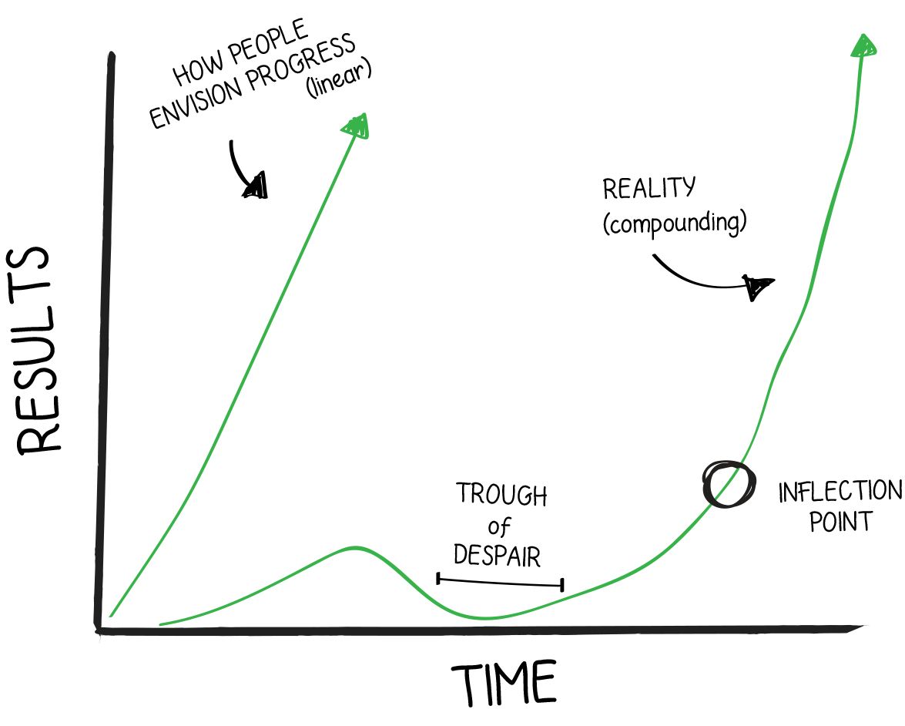
The Inflection Point
The inflection point is a moment in time where exponential growth is possible and you can rapidly level up your business.
Normally, this is an individual event: you may be at an inflection point where you’re positioned to level up rapidly, but I may not. That’s because it’s the byproduct of compound interest: consistently releasing books, getting better at marketing etc.
Right now, the publishing industry is at an inflection point. Over the next 24 – 36 months, almost every author can rapidly level up because new AI tools allow us to produce 5x or 10x more work while maintaining or improving quality.

Slide 6
02
WHAT’S CHANGED OVER THE PAST 3 YEARS

Slide 7
What’s Changed?
2023: copying and pasting lots of prompts to produce things like blurbs or ad copy faster
2026: higher quality output, much faster or even on auto-pilot

Slide 8
What’s Changed?
Output quality: AI marketing copy / images consistently beat human ones.
Automation: AI can effectively do many marketing, admin, or writing related tasks at an expert or better level on its own. This hinges on you taking the time to distill a task or workflow into a clear process. You can also connect AI with software tools to extend its functionality and have it execute tasks in those programs on your behalf.
Context: AI now has persistent memory, so it can remember details about your books / business / life to customize output and advice to your specific career.
Quantitative Analysis: Much better at doing math / analysis now because it can use tools to crunch numbers.

Slide 9
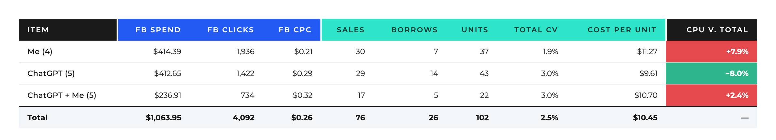
AI v. Human: Facebook Ad Copy
This is from 2023

Slide 10
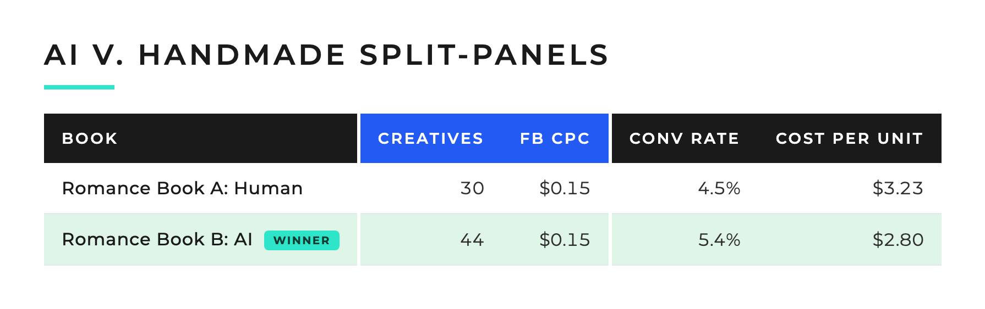
AI v. Human: Facebook Ad Images

Slide 11
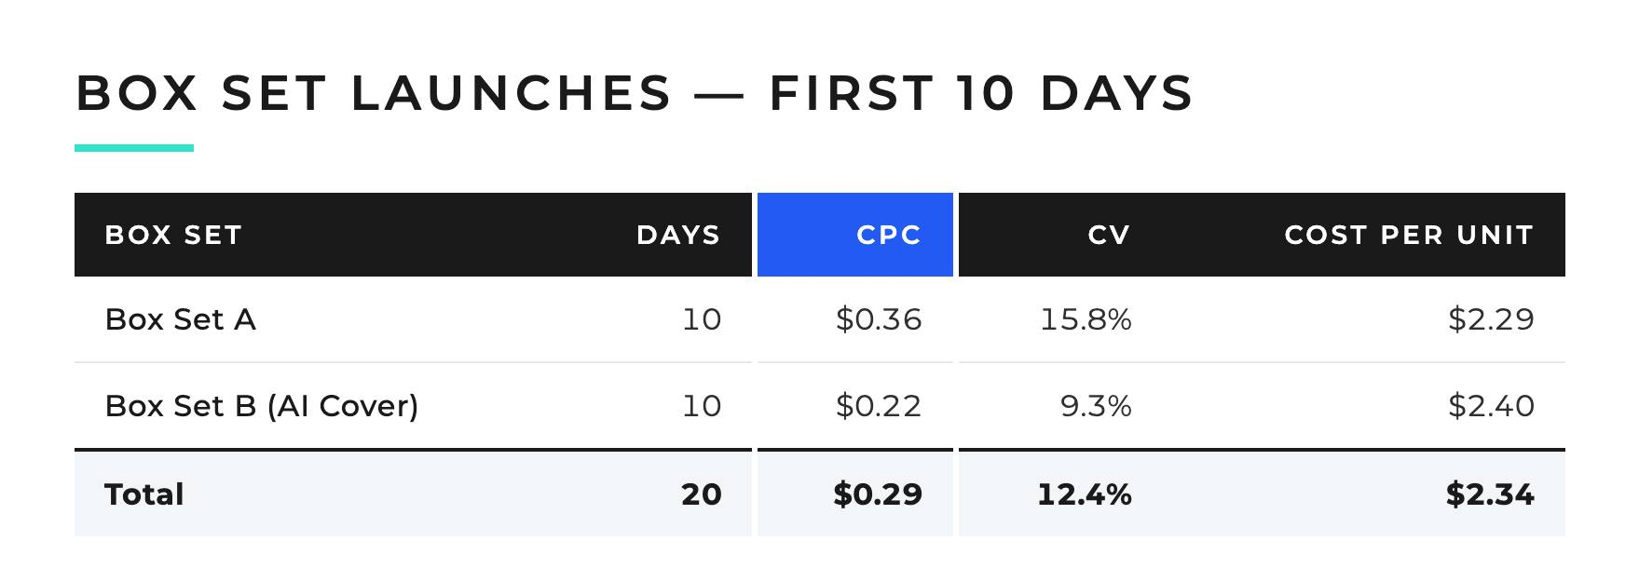
AI v. Human: CoVErs

Slide 12
What Does This Mean?
Near mystical hype aside, AI is just an extremely cost-effective form of automation / outsourcing.
Software (automation; e.g., a spreadsheet) or a person (outsourcing; e.g., a cover designer) may be better options for a given task. Choose based on what’s best for that job and how you want to run your business.
Fundamentals matter more than ever.
  Fundamentals: Testing ads, tracking, making good ad creatives / social media posts, market research, getting good blurbs / covers / titles, writing good commercial books.
Bad fundamentals x automation = rapid negative compounding
Good fundamentals x automation = nitro fuel
Extreme fundamentals x extreme automation = exponential growth and the golden age of the creative solopreneur

Slide 13
As 1 Person in July…
Made 562 Facebook Ads for clients
Also made the creative elements (images + copy) for most of the 417 Facebook Ads that ran for another author
Made a BigQuery database (this cost me $20k+ over the years between the dashboards, actual database and so forth)
Launched + ran a 5 day live course (this was not AI)
Estimate: this output is maybe 5 - 10% of what I could automate / speed up / improve with current technology (even if nothing improves with the AI)

Slide 14
Example Use Cases
Writing
  Series bible
  Editing (proofreading, copyediting, fact checking, developmental editing)
Marketing
  Market research
  Ad copy / blurbs
  Images
  Videos
Admin / Marketing
  Ad analysis
  Profit tracking
  Launching Facebook Ads

Slide 15
The bottom Line
You now have the creative freedom to run the business you want.
My approach: throw a task to AI and see if it can do it. Then refine if it shows promise / is useful.
And have fun with it.

Slide 16
03
AUTOMATING WITH CLAUDE COWORK

Slide 17
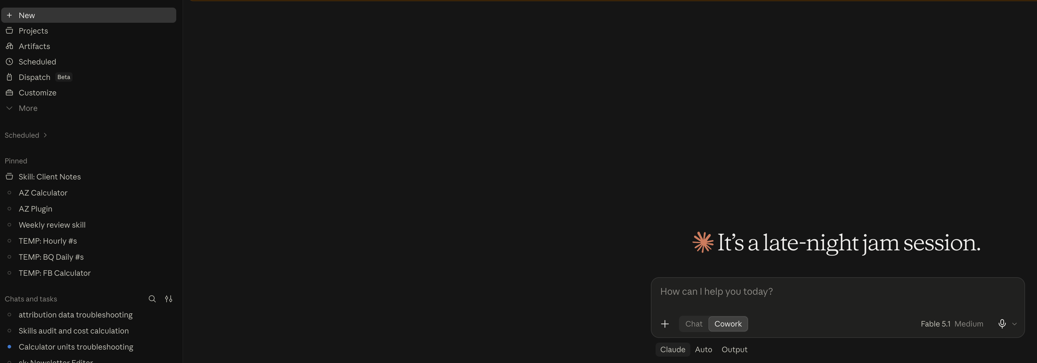
Claude Cowork
Desktop App
claude.com/download

Slide 18
Claude Cowork: What IS IT?
Cowork is included with your Claude Pro subscription ($20/mo). I’d recommend the Max plan ($100/mo - $200/mo) if AI is a core pillar of your business.
  ChatGPT Work is OpenAI’s version of Cowork
Claude Cowork is an agent. An agent is something or someone that can perform actions on your behalf.
  E.g., real estate agent sells your house on your behalf
  An AI agent performs tasks for you using tools (like the browser, Google Docs, Canva etc.) and context (information, data etc.)
  In other words: it can do stuff on its own. This means you can work asynchronously: give it a task, go do something else, then come back. You can even have Cowork do multiple different tasks at the same time.

Slide 19
Claude Cowork: What IS IT?
Cowork uses the same interface + model as the regular chat-based Claude (use Opus 5.5 or Fable 5.1).
  I recommend using the desktop app because it syncs with the web app but can access, edit, and create files on your actual computer. Give it a dedicated folder to work in. This reduces friction (no downloading, uploading tons of files).
  It also has more context since you can include documents in this folder with info on your business / yourself that it pulls from each time you execute a task.
  You can also schedule tasks on a recurring basis.
This is the single most powerful / transformative piece of software I’ve ever used.
  ChatGPT / Claude = dial up
  Cowork / Claude Code = broadband

Slide 20
Demo: What aBout This 90% Claim, Man?

Slide 21
04
SKILLS: FRAMEWORKS

Slide 22
Cowork: Skills
Skills are the most powerful part of Cowork. They are also available in regular chat-based Claude.
A Skill is a step-by-step process (SOPs), similar to a prompt. The difference is that a Skill can execute much more complex tasks automatically without copying + pasting. You can also have a Skill call other Skills as part of a longer workflow.
Once you build a Skill you can use it whenever you want.
Building a Skill not only automates the task, but also allows you to refine the process over time as you learn new things or think of new features.
Key takeaway: you can now execute the ideal version of a process that no human would have time / energy to do. And you can consistently iterate on that process to improve it further.

Slide 23
Cowork: Skills
You can also transfer Skills to other people (members of your team or an author friend) in a near 1:1 manner. Meaning I can send you a Skill that I made and then you can install it in Claude.
This is the most seamless knowledge transfer out of any medium I’ve ever encountered.

Slide 24
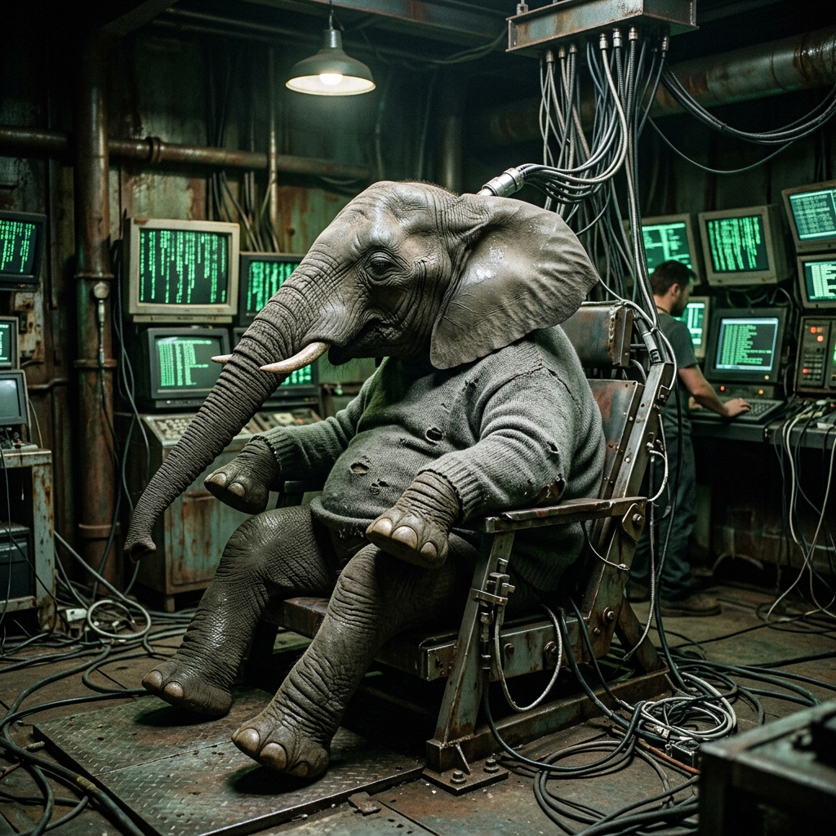
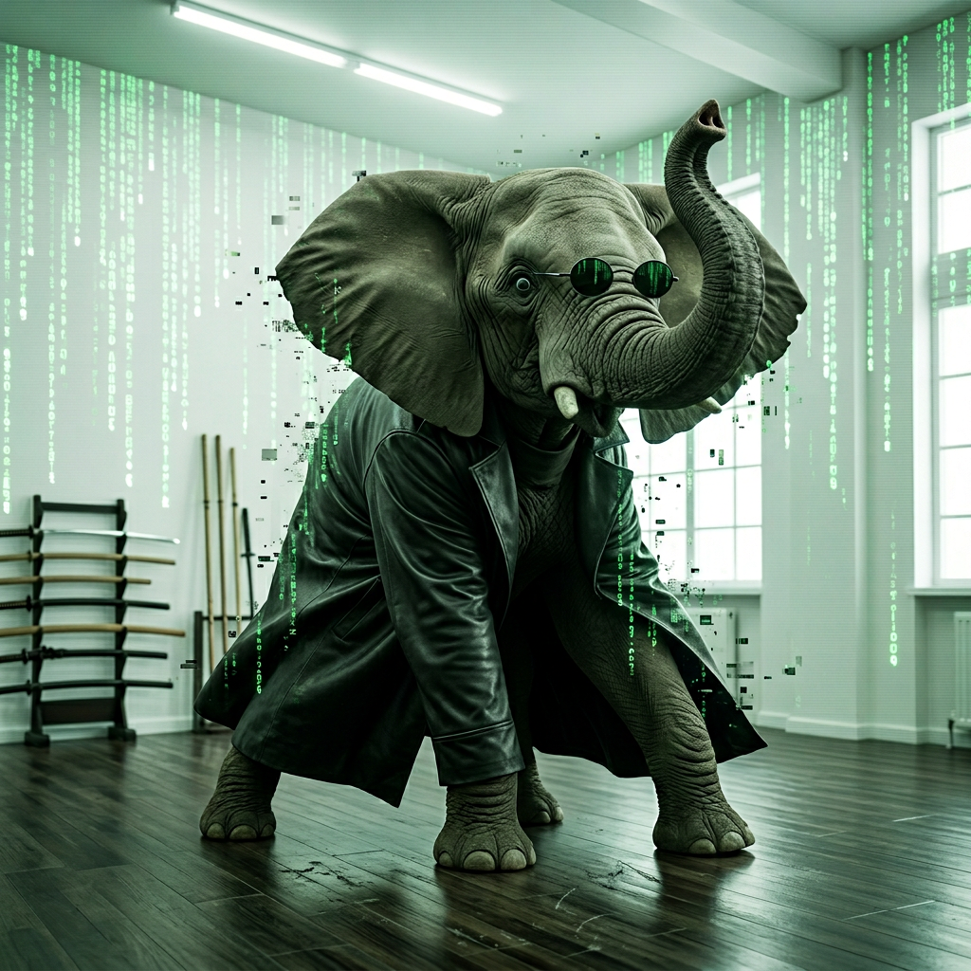
“I Know Kung-Fu”

Slide 25
What’s In a Skill?
A Skill is basically a text file with instructions (.md = markdown) + any scripts that the Skill needs to execute.
Claude makes all of this on its own.

Slide 26
A Good Skill is Basically Two Things
Think of this like outsourcing a task to a human being. What would they need in order to do a good job?
Process: instructions on the task + how to do it step-by-step
Examples: what you want and what not to do
  Can be just one example, but preferably 2 – 5
  Examples of what good / correct output looks like
    Images: different examples of an image formula
    Analysis: equation + examples of solved equations
  Examples of things you don’t want or bad / wrong output with the corrected version
  1 skill per process. E.g., blurb writing is 1 skill, writing ad copy is a different skill.

Slide 27
Review Agents
You can ask Claude to add a review agent to a Skill.
This review agent can separately verify that critical pieces of information are correct. This improves the accuracy of the output.
Examples
  A review agent can verify the accuracy of a blurb or ad copy against the actual manuscript.
  Can verify math to ensure calculations are correct
  Can look at images it just generated to verify that no glitches occurred or that the images are compliant with guidelines you’ve given it (e.g., for Facebook Ads, no guns pointed directly at the user, no alcohol)

Slide 28
Important
This takes work to get good output.
Some basic skills, like the one I use for writing blurbs, have taken me 5 – 10 minutes to initially make and get 80% of the way there, but 5 – 10 hours to refine.

Slide 29
Process 1: Do Stuff → Skill
Process 1: Do Stuff, then Turn it Into a Skill
Get Claude to do a task.
If you like the output, ask it to turn that process into a Skill when you’re done
Then the next time you do this task, ask it to use that Skill.
Then you can refine the Skill over time to improve the quality of the output and add new features.
This is the easiest way to start automating + speeding up tasks you’re already doing with AI and improve the output.
Don’t worry about being perfect. You learn to create better Skills by actually making them.

Slide 30
Process 1: Do Stuff → Skill Example
Ask Claude to proofread a chapter, newsletter etc.
Apply the corrections to your document.
Copy + paste the revised version in the same chat and ask for additional edits. Continue until you’re finished.
Once you’re done, ask it to create a Skill that captures the edits you made as well as the ones you didn’t make so that it starts to learn your preferences and what it should be looking for. This captures tacit elements of your editing process that are hard to describe.
Use the Skill next time you’re editing a chapter, newsletter etc. and try to add a feature or refine the skill.
  Example: continuity check where it looks at the series bible and makes sure that no dead characters came back to life.
  Example: for my newsletter, did I give an example or data that helps demonstrate what I’m teaching in the newsletter

Slide 31
Process 2: Processes / Frameworks → Skills
Take a step-by-step process or framework and turn it into a Skill.
  This can be your own process / framework that you write out.
  It can be from existing AI prompts that you’re copying + pasting that you want to turn into a Skill
  It can be from a course, book, video, blog post etc. This allows you to instantly start applying a resource.
    Resources that work well are ones with a clear step-by-step process + example(s)

Slide 32
Process 3: Reverse Engineer
Give Claude a blurb, piece of ad copy, social media post, image, video, then reverse engineer it into a formula / framework and make a Skill that can generate similar output.
Multiple examples work best here, otherwise you tend to get output that resembles the original too much.
Specifically telling Claude not to mimic the original 1:1 is important.

Slide 33
EXERCISES
nicholaserik.com/ninc-2026-exercises

