Slide 1

AI and Automation
THE 10x AUTHOR: HOW TO ACCELERATE YOUR CAREER WITH AI and AUTOMATION

Slide 2
The Inflection Point: Opportunity and Uncertainty

Slide 3
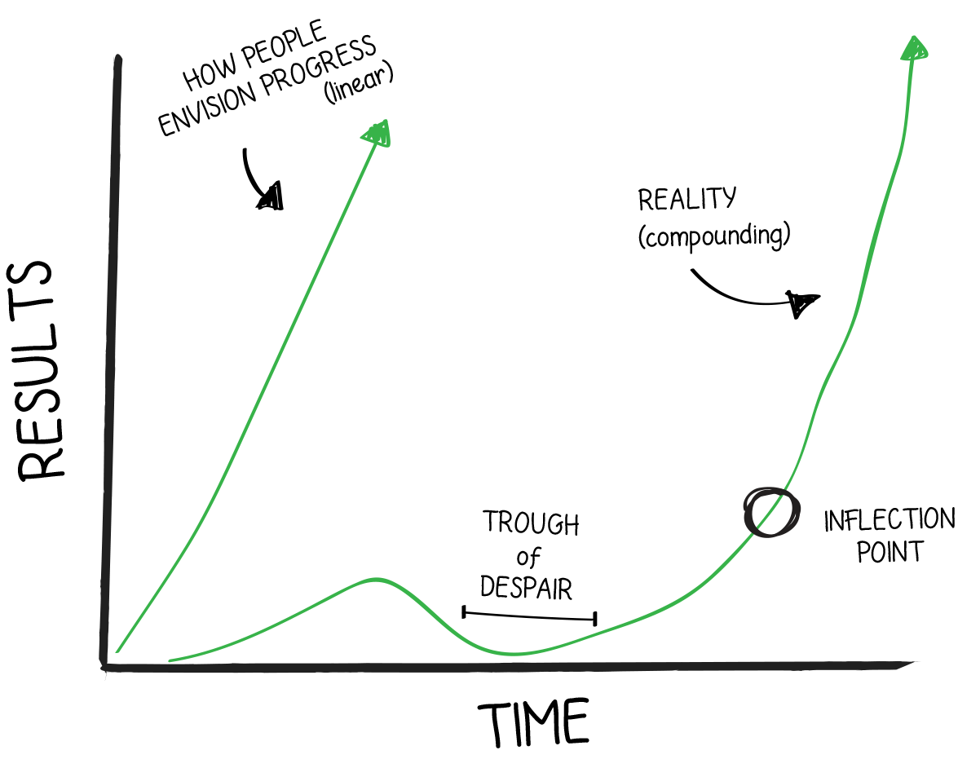
The Inflection Point
Rise of the solopreneur: at an industry-wide inflection point (where growth can hockey stick and become exponential) due to inexpensive tools available that can automate and solve common business problems due to either AI or cheap software
Exponential growth: 10 – 30% increase in productivity monthly if you embrace automation and AI (this obviously doesn’t scale indefinitely).
100x overall increase in productivity possible.
10x overall increase in productivity possible even if you’re already at the upper end of productivity.
E.g., going from 25 FB creatives a week to 250 (the max you can run under a single page).
But real benefit comes from higher quality. AI + automation streamlines tasks that are low value (but necessary) or things that you don’t like doing so that you can focus on what you do enjoy and are good at. And it also helps you improve those areas where you’re already strong (feedback, following frameworks, idea generation etc.)
2 – 3 year advantage: not game over for your business if you don’t embrace this, but huge opportunity because few people are using AI / using it well.
GenAI is the best at generating text (images and videos being just behind) out of any use case. Ignoring / avoiding the biggest invention since the printing press is an ineffective strategy.
You will definitely be playing catch up in 2029 if you wait to dive in then because this technology is not going away (trillions invested, already embedded in basically every major app-–Docs, Office, Gmail etc.)
this is like a free bonus multiplier for all your effort right now since few other authors are embracing it

Slide 4
AI: Actual Impact?
AI is a bubble. That doesn’t mean it’s not useful or a massive opportunity.
During a bubble, you always hear “this time is different” and that the old paradigm no longer exists / matters.
AI is just a new form of outsourcing / automation. The reason it changes things is because of its low cost + being embedded in practically every piece of software and hardware as infrastructure.
Infrastructure takes many years to build. Enterprises are struggling to incorporate AI into their workflows due to security / privacy concerns etc. of popular chatbots forcing them to make custom solutions
95% of enterprise projects result in 0 return (MIT NANDA study: “The GenAI Divide: State of AI in Business 2025”)
METR study: “Measuring the Impact of Early-2025 AI on Experienced Open-Source Developer Productivity”
16 experienced developers, “When developers are allowed to use AI tools, they take 19% longer to complete issues”

Slide 5
AI: Actual Impact?
Wharton Human-AI Research: “Accountable Acceleration: Gen AI Fast-Tracks Into the Enterprise”
“Returns are emerging, with scale as the next test. Nearly three-quarters already see positive ROI, and four in five expect positive returns within two to three years. VP+ feel the most optimistic, having more positive ROI perceptions than mid-managers (81% believe ROI is positive vs. 69% for mid-managers)
“Tier 1 enterprises ($2B+ annual revenue) are more likely to report “too early” outcomes today as they navigate integration complexity. Midsized Tier 2 ($250M–$2B) and smaller Tier 3 (<$250M) firms report quicker ROI realization.”
“Nearly three-quarters (72%) of business leaders report tracking structured, business-linked ROI metrics (profitability, throughput, workforce productivity), optimizing not just for adoption but for measurable outcomes.”

Slide 6
What About for Book Marketing?
Tested for same book at same time, using same settings / audience / images etc.
3 Book Box Set: wrote a blurb that got 26% conversion during pre-order tests at 99p (me + ChatGPT)

Slide 7
What About for Book Marketing?

Slide 8
What About for Book Marketing?
This was back in 2023

Slide 9
The Two Paths Forward

Slide 10
AI vs. Automation: The Difference
Automation can involve AI, but doesn’t have to.
Non-AI: Mailing list autoresponder, ad rules (Bir.ch, BooksFlyer)
AI: automatically label incoming emails in Gmail according to topic (e.g., about book marketing, AI etc.); need AI to analyze text of email
Likewise, AI can be incorporated into an automation workflow or perform tasks automonomously, but it isn’t necessarily automated.
ChatGPT: manual back and forth chat.
ChatGPT DeepResearch: automatic research based on your prompt (e.g., research
OpenAI API in an agent workflow that creates social media posts: automatically triggered by some action (e.g., someone filling out a form or dropping a manuscript into a Google Drive etc.).
Basically takes what you’d be doing in a manual back and forth chat and automates it.
This is extremely challenging (much more than people tell you)
Outsourcing: still an option to outsource to a human
Discernment is key when deciding who is best for a task. This requires domain-knowledge

Slide 11
Path 1: Rebuild Your Business As Ai / Automation First [Recommended]
Look at current processes and ask: “What can I automate here?”
Then try to automate basically every repetitive task that you don’t want to do, that you don’t do well, don’t do consistently, or takes time away from a higher ROI activity
AI + automated processes are infrastructure. In other words, they’re the foundational layer on which your entire business (and a lot of society going forward) will rest upon, like water or electricity.
This requires reconceptualizing your entire business. Because things that were impossible due to skill, cost, or time roadblocks are suddenly possible. This emergent possibility can help your business evolve into something dramatically different.
E.g., iPhone: GPS + screen + always on internet access in a single device = Uber
This is not about adding AI to everything (or automating everything). That is dumb. Equally dumb is claiming “I can do it better myself” (most things you can’t, and you’re actually bringing negative value to the business by doing them).
IMPORTANT: you can still take an artisan, craftsman’s approach to your work and business. This is about increasing consistency + quality.
Filter: is this beneficial / useful for my audience?

Slide 12
Path 2: No AI Whatsoever
Structure your brand and business around not using AI (e.g., like Made in USA is a selling point).
Problem: this is basically impossible and a lie, so you’re setting yourself up for disaster.
Like positioning yourself as a horse-only business after the creation of the automobile.

Slide 13
Principles of Effective Automation

Slide 14
The 90% Problem
AI is very good at generating impressive looking demos / drafts etc. and due to its confidence, the output looks extremely legit but is not actually useful in the real world.
Making something that’s actually 100% of the way there requires actual SKILL. You need skill in the domain to actually make something usable if the problem is remotely complex.
Most these “vibe-coded” or “one-shot” projects are bullshit that generate massive negative value. The person either never finishes them, or if they do, they have major flaws like huge security holes.

Slide 15
Principle 1: Iterative Trial and Error Builds More Valuable Assets
There are two main advantages of automation: greater consistency (generally 99%+ uptime) and greater quality (proven process executed the same / similar way every time).
The impact of consistency is overlooked and underestimated because quality may be reduced / may be variable compared to a human (e.g., you), especially with AI.
So people avoid automation because “they can do it better.”
Would a customized email to every person who signs up for your newsletter build engagement better than a standardized welcome? Maybe. But practically impossible.

Slide 16
Principle 2: Compounding Works Both Ways
Any automation that generates negative value will have 99%+ uptime. That means it will compound really quickly in a negative direction.
Example: Bir.ch (created 40+ duplicate ad sets on Facebook), BooksFlyer (increased bid for poor performing keyword)
These were problems with the rule logic that I set up, not problems with the software. I monitored them and caught them.
Verification is mandatory. It takes the most skill + most time and is generally the most frustrating / boring, so it is easy to skip.
With static rules-based logic that executes the same way every time (like bids management software or a spreadsheet), verification is once / after you make an update to the logic.
With AI generated content, human verification is ongoing, where you often need a human to give the final yes / no decision.
Skip this or fall asleep at the switch and you will get burned, especially with AI where its outcomes are variable.
Example: some developers don’t check any of their AI-generated code anymore (massive security risk), don’t need to check output of AI sending emails or whatever.
Or people give OpenClaw / Claude Code (or some other AI agent) unrestricted access to all their files.
People jump into these automations because of FOMO / worry and get burned.
This is bubble talk about how fundamentals no longer matter.

Slide 17
Implementing This in Your Business

Slide 18
Process
Level up core skills and build solid foundation: marketing + writing, then decide how you can amplify.
Filter: is this a net positive for my audience? Then: is it a net positive for my business?
Break an area into its component processes.
E.g., can’t automate / create a workflow for ”marketing” or even “Facebook Ads”
Facebook Ads, however, can be broken into: ads management (turning ads off / on), tracking (entering numbers in a spreadsheet), analysis (calculating cost per unit and other metrics to determine what’s working), making creatives, and actually uploading ads
These may be automated / streamlined to a certain degree. Automating is not always the best approach; sometimes it’s outsourcing or even leaving things as-is (e.g., most people do not want to automate the writing of the books, but they may want to automate / semi-automate the series bible creation).
Master the process manually. Any process that is automated or semi-automated requires maintenance and troubleshooting at some point. This requires actual skill and knowledge of how the various pieces function. Either need a freelancer / staff member to maintain it, or you need to do this.
BigQuery pipeline example
Map out a process. You can use bullet points or a wireframe.
Decide whether you need AI or not to automate aspects of the process. (note: you do not in many cases)
AI is useful when there is it’s not a yes / no answer (e.g., is this ad hitting this cost per unit? Is a yes / no answer) and requires something to analyze the sentiment / meaning to make a decision (a human may be required) or you’re generating something (e.g., video, text, audio)
Ads Management: I as the human can come up with much better guidelines that I, in turn, want a piece of software to execute consistently. If AI has the autonomy to make “decisions,” then the outcome is far more variable, which I don’t want.
Ad Creative: makes ad creatives on its own without input (test prompts to make sure you’re getting the output you want) which saves massive amount of time.
Monitor the process and verify that it’s working correctly (note: it probably is not at first).
Have an error log / automatic notifications to let you know if something has gone awry.
Do not overcomplicate things.
Personal tracking sheet example

Slide 19
Skills are More Valuable than Ever
Assets, processes, systems: these are all critical to build as a solopreneur because they make your workday vastly more efficient.
Use automation / AI to amplify existing processes and systems (execute them more consistently and / or better)
However, you want to remain agile and flexible enough to test and replace outdated or broken processes and systems.
Learning: fundamentals, double down on fundamentals and be learning new stuff constantly to build on top of this
Fast decision making: faster your feedback loop, faster you learn; willingness to “fail” (trial and error)
Discernment / curation in the face of infinite choice + infinite information—you are trying to transform insight into information

Slide 20
Biggest Leverage Points
You have four main assets as an author: your books, skills, newsletter, and data.
In the age of AI, if you use AI well, the data becomes more valuable than anything other than the books.
For non-AI automations
Ads: Bir.ch / Booksflyer
Ads / General Tracking: Spreadsheets (templates, macros)
Automation workflows: N8N (or Zapier, Make)
For AI: Pick one program and actually use it to automate / save time doing something useful.
For AI, prompt engineering is the most valuable skill and will apply to all of these.
Standard Claude or ChatGPT web apps (recommend most authors focus effort here, biggest returns)
Creating small pieces of code (Google Apps script, Python, spreadsheet formulas etc.) to bridge gaps / call APIs etc.
N8N (or Zapier, Make)
Claude Cowork
Claude Code
This will take probably take 10 – 20+ hours to hit that 100% mark if you’re starting from zero. Get started. [billed twice annually for Zapier before I jumped in with N8N]
This means for the first month, your efforts will likely have 0 return or even a negative one, where you’re taking time away from other projects.

Slide 21
Real Automations (#1: Non-AI, #2: AI): Demo

Slide 22
END

