Slide 1

MASTERCLASS
HOW TO BUILD TO SIX FIGURES
(WITH BASICALLY NO SOCIAL MEDIA)

Slide 2
OVERVIEW
ACTUAL STRATEGY: I have personally used this marketing strategy to help multiple clients build to six figures.
  Simple
  Kindle Unlimited only; can take principles / ideas, but relies on things like Prime + Kindle Countdown Deals
  If paid advertising isn’t a strength, this probably isn’t going to work
  Can do social media, but not required

Slide 3
STRATEGY
STRATEGY: a set of cohesive tactics (action items) all pulling toward the same core objective.
  Gives you structure (North Star) for when things get rocky.
  I use the analogy of a sled dog team.
  If half the dogs are distracted / not pulling their weight, progress slows.
  If half the dogs are pulling in the wrong direction, you stall out and die of exposure (give up).
  This isn’t about having more dogs, it’s about whatever dogs (actions) you’re taking all pulling toward the same destination.

Slide 4
STRATEGY COMPONENTS
CORE OBJECTIVE: make six figures
STRENGTHS: ads, launching / promos, analysis
WIDE / KU: Kindle Unlimited
RELEASES: 4+ 40,000+ word full-length novels in a single series. Start seeing scalability with the ads / revenue going up at Books 6 / 7 / 8.
TRAFFIC SOURCES: 1 – 2 main traffic sources. Probably be focusing on promo sites + one ad platform (Facebook or Amazon), but could throw in a social media site (TikTok).
  Submit consistently to BookBub as often as eligible.
  Can submit for 99c, then free right away w/o waiting.
TACTICS: Kindle Countdown Deals / Prime Reading
TESTING: test blurbs / covers to improve packaging.
PRICING: $1 is not $1. $3.99 is 33% more than $2.99. Can usually price later books (after Book 3 / Book 4) in the series at $4.99+.
NEWSLETTER: build organically (novella / bonus scene or epilogue in front + back matter), send monthly [can be weekly]
TRACKING: monthly royalties and expenses (accounting) + organic newsletter subscribers / weekly (ads) [can be daily]
FORMATS: eBook / print

Slide 5
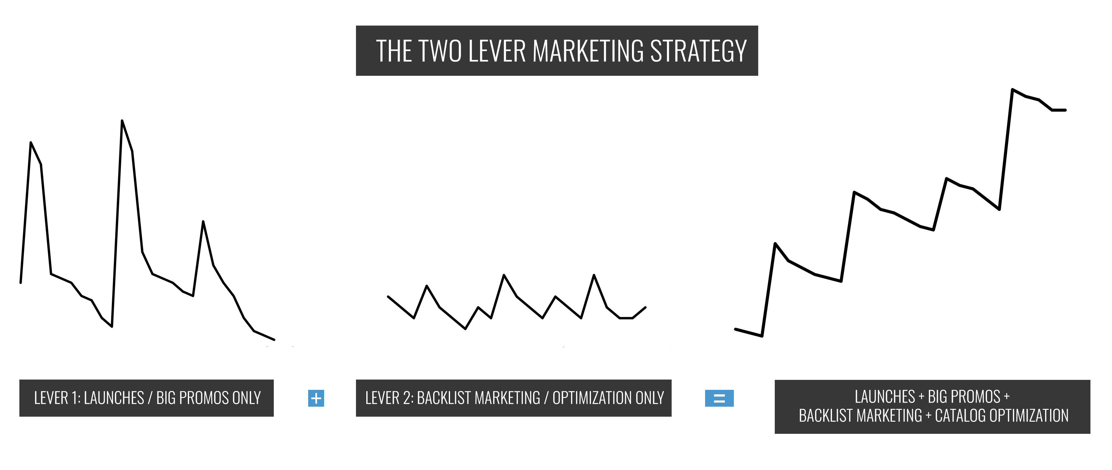
THE TWO LEVER STRATEGY

Slide 6
THE TWO LEVER STRATEGY
LEVER 1: Pushing launches and promos hard to leverage Amazon's algorithms as much as possible, usually with Kindle Countdown Deals.
  Stack things together around the launch—e.g., BookBub + launch + KCD to push volume.
  Or stack things up when you have a large piece of firepower outside of a launch (BookBub, Prime Reading run where you get paid)
​LEVER 2: tweaks and ads to prolong tail from launch / promo.
  TEST: Optimization (test blurbs / covers / prices etc.)
  ADS: Backlist ads ($50 - $100/day)
  BABY KCDs: Smaller KCDs or free runs between launches to boost visibility / sustain momentum.
  BRIDGE: Use assets like box sets strategically to bridge earnings dips without having to write more words.
  BOOKBUB: Submit to BookBub consistently.

Slide 7
CORE IDEA
Consistency + good books + long series + same genre = compounding
Use massive sales volume of KCDs to trigger algorithms (gain visibility / boost tail) and also generate mailing list subscribers / fanbase.
  Good books: get them in as many hands as possible.
Prolong momentum between launches with ads.

Slide 8
THE THREE MAIN TRAITS OF SIX- and Seven-Figure Authors
Consistently publishing books that deliver what readers want in the sub-genre. Finding the crossover between what the market wants and what you like to write (and what you're good at writing) is key.
Good packaging (blurbs / covers) that appeals to readers of the sub-genre.
Building the newsletter.
Testing is a way to accomplish #2 quickly.
Massive sales volume + big promos / launches are a way to accomplish #3 quicker.
But there are other tactics.

Slide 9
BUDGET
There is a heavy focus on paid advertising.
Calibrate this based on your current cash; might not make sense to pursue some of these tactics depending on cash on hand.
Err on the side of being less aggressive to start, even if you have the budget. Marketing skills build over time.
Don’t use a credit card. Instead:
  Invest money in your cover first, before ads. This will be the highest ROI.
  Then testing covers / blurbs.
  Then ads.
  Put aside money each month to save up for larger promos / launches.
  Reinvest royalties / profits into the business to build faster.
  Explore cheaper / free sources of traffic: swaps, TikTok
  This seems slower, but will usually be faster in the long run. Lots of variance in this business; promos / launches can flop.

Slide 10
MEGA KCD: OVERVIEW
BUDGET: $1,500+ (preferred: $3,000+)
USE CASES: launches, promos
KCD: at least Books 1, 2 & 3 at 99c each—can do more; aim to get Book 1 into Top 1k of US Store
  Can do one of the books at free if you have a smaller budget or if you get a BookBub on it
  Can do with a wide book, but only get 35% royalties so harder to turn a profit.
TIMELINE: all 7 days (5 if one of the books is free)
SCHEDULE
  Test aggressively first 2 – 3 days to nail down authors / creatives
  Keep sales going during 7-day period
  Hit hard last two days to exit at peak rank. Aiming for 50 – 75% of your budget on these days.
  Then, after, prolong tail and pin Book 1 in top 10k with $50 - $100/day (equilibrium point) in ad spend. Might be able to push to $200.
  Don’t push in both US + UK unless you have a large budget / strong with ads
TRAFFIC SOURCES: newsletter / swaps / social media / promo sites / Facebook + BookBub Ads, potentially Amazon Ads

Slide 11
MEGA KCD: PRICING
Options:
  Books 1, 2 and 3: FREE / $0.99 / $0.99 (second choice; any book can be free, doesn’t have to be Book 1)
  Books 1, 2 and 3: $0.99/$0.99/ $0.99 (preferred)
  Books 1, 2, and 3: $0.99/$1.99/ $2.99 (not recommended)
Can discount more than Books 1, 2 & 3 when using KCDs

Slide 12
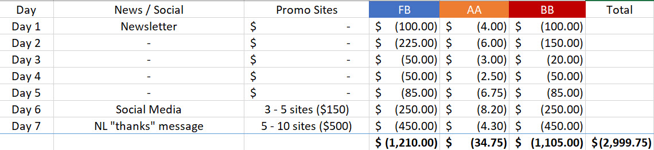
MEGA KCD: SAMPLE SCHEDULE

Slide 13
PRIME RUN: Blueprint
BUDGET: $0 - $50,000+
KEY: paid for inclusion in Prime. This means Amazon has skin in the game and will provide algorithmic help. Does not work with Prime books you don’t get paid for.
PRIME: can be used in US or UK to get into Top 100 / 500 / 1000 (ceiling dictated by genre; romance / thriller can hit Top 100)
  Can be combined with a KCD to get over the initial visibility hump
    E.g., going from 5000 > 500 in store can be expensive with just ads to a full price book in Prime. Can use the KCD to close that gap and then pin the book there with the ads—momentum generally sustains if ad spend is high enough.
TIMELINE:
  90 days: start testing and trying to scale ad spend as soon as your book hits Prime
TRAFFIC SOURCES: Facebook Ads / Amazon Ads / newsletter / swaps / social media / promo sites (if combined with a KCD) / BookBub Ads (if combined with a KCD)

Slide 14
PRIME RUN: Traffic Notes
  Facebook tends to be the cheapest option for when the book is regular price; don’t push the Prime Reading angle directly, can just use normal creatives (teasers, excerpts, etc.)
  Use Dynamic Creative on Facebook to test lots of different options rapidly
  If trying to spend $1000+/day on Facebook, be prepared to test 30 – 50+ images and pieces of copy during the course of Prime Reading to keep creatives fresh.
  Amazon Ads can be effective as well, but Prime Reading downloads don’t show up in ad dash stats so can skew your view into how ads are performing (e.g., something could have no sales / reads but be generating downloads)
  Generally fine, but just keep an eye on things to make sure performance is okay
  Don’t target “prime reading” as a keyword on Amazon Ads, very expensive and ineffective
  Prime has 148m US members. Don’t forget your newsletter, social, and swaps for generating initial momentum. These can do a ton of heavy lifting.

Slide 15
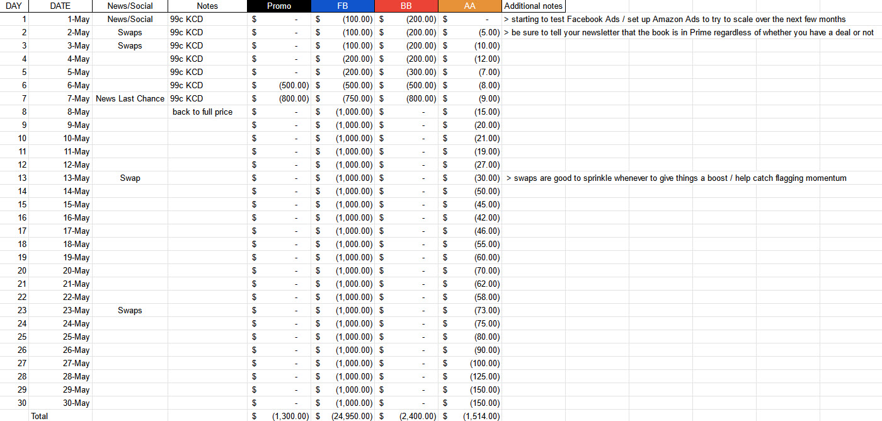
EXAMPLE: First 30 Days

Slide 16
RELEASE & PROMO SCHEDUlE
Jan: release
Feb: $50/day
Mar: $50/day
Apr: $50/day
May: release
Jun: $75/day
Jul: release
Aug: $75/day
Sep: 99c KCD
Oct: $75/day
Nov: $75/day
Dec: release
Jan: release
Feb: $50/day
Mar: box set
Apr: $75/day
May: release
Jun: $75/day
Jul: release
Aug: BookBub on box set
Sep: 99c KCD
Oct: Prime Reading
Nov: scale to $100/day + Prime Reading continues
Dec: release + Prime Reading continues
BRIDGING w/ BOX SET
BACK TO BACK PROMOS / RELEASES BUILD MOMENTUM RAPIDLY
(LOOK FOR THESE OPPORTUNITIES)
AIM: promo or launch every other month; can turbocharge results by doing one per month.
NOTE: you’re usually keeping the backlist ads on during release / promo months (if they’re effective). So any money for the launch / promo would be in addition to what you’re already spending on ads.

Slide 17
ADAPTING (UNIVERSAL PRINCIPLES / IDEAS)
  If you’re wide / not using a ton of paid advertising etc. most of these principles and ideas still apply.
  PRINCIPLES
    A strategy will help focus your actions toward the same objective.
    Be consistent with production / the marketing tactics you use.
    Once you have a good product, find ways to get it in as many people’s hands as possible (builds newsletter, fanbase, and word of mouth) [using KCDs / Prime Reading here, but a variety of other things]
  RELEASES: write 4+ full-length (40k+ word books) a year in a series; focus on one series (so long as it’s showing signs of life), start to see royalties accelerate around Books 6 / 7 / 8
  TWO LEVER STRATEGY: push launches / promos strategically, then sustain momentum via backlist ads + catalog optimization and using smaller promos / box sets to bridge royalty / momentum dips. Promo / launch every other month (turbocharge by doing every month).
  TRAFFIC: focus on 1 – 2 main sources to start. Promo sites / BookBub + either Facebook or Amazon (learn one ad platform at a time).
  TESTING: blurbs / covers (for Book 1)
  PRICING: $2.99 (B1) / $3.99 (B2) / $3.99 (B3) / $4.99+ (B4 onward)
  NEWSLETTER: weekly or monthly, build with a novella / epilogue or bonus scene sign-up link in front + back matter
  BOOKBUB: submit consistently (more likely to get this wide)
  TRACKING: monthly royalties and expenses (accounting) + organic newsletter subscribers / weekly (ads) [can be daily]
  TACTICS: look for ways to leverage retailer tools / merchandising (other retailers have special promotional options as well)

Slide 18
END

