Slide 1

Case Study
BREAKING BOOKBUB: FINDING BEST PRACTICES and PATTERNS to OPTIMIZE AD SPEND

Slide 2

TEST BOOK
GENRE: Urban Fantasy
RELEASE: June 2021
PRICE: $0.99 / in Kindle Unlimited
Spent about $6500 - $7000 on BookBub Ads to this book prior to running this test

Slide 3
TESTING: QUESTIONS
How accurate / what could I use the attribution links for > use an ad platform I was familiar with
How well do BookBub Ads convert in sales / KU? > use an attribution link
Which creatives convert better than others? > naming convention for creatives, use a specific attribution link for each specific creative
Which creative elements convert better than others > coded naming convention for each creative element, use a specific attribution link for each specific creative
Which audiences convert better than others? > coded naming convention, use a specific attribution link for each specific ad and audience
More granular you get with tracking, the more questions you can answer at once; also future proof your data to answer questions you potentially haven’t thought of yet.
Answering all these questions at once: coded naming convention, use specific links for each specific ad and audience

Slide 4
AD and Link NAMING CONVENTION
Allows you to isolate individual elements
  Can drill down extremely far if you’re comfortable with spreadsheets
  Can still drill down in the ads dashboard even if you have no / minimal spreadsheet skills
  Maintain a creative key in Google Sheets listing creative elements and audiences; can also include various details (see example)
  Count up across all books / account from 100 (e.g., if G100 – G107 are all images for Tess Skye, then I switch to Eden Hunter, I’d start at G108)
  Image = G100
  Headline = H100
  Sub-Headline = S100
  Audience = A100
  Aggregate Audience = AG100
  Ad code must match with corresponding link code

Slide 5
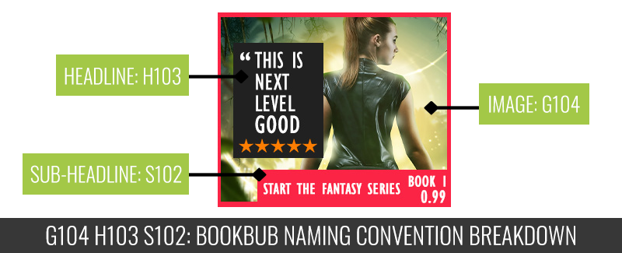
AD: Example

Slide 6
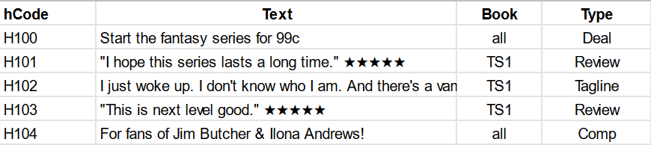
KEY: EXAMPLE

Slide 7
NAMING: Example
BOOKBUB AD NAME
This has some additional info in it (L5 = fifth round of testing, 7 = 7th creative testing, 3%+ = audience)
This is for to actually read as I’m looking at and managing the ads to help me identify what’s running
I keep the separator consistent here (“>”) so that I can easily use the SPLIT function in Sheets to break the pieces apart
AMAZON ATTRIBUTION LINK NAME
Amazon calls the links “ad groups”
This can also have additional information in it, but I find it easier / cleaner to just have the code.
I’m generally not spending a lot of time crunching numbers / analyzing data on the Amazon Attribution dashboard itself; I export the data and then crunch it in a spreadsheet.

Slide 8
DATA: How Well DO THE ATTRIBUTION LINKS TRACK?
When you’re testing a new feature, you need to make sure you have a clear measuring stick.
I was testing TikTok Ads at the time, but this would introduce two variables: TikTok, and the attribution links.
I’ve run a lot of BookBub ads and have estimated conversion in a variety of ways in the past.
BookBub Ads conversion estimate: 5 – 10% for a 99c book in 2022
Attribution links: 5.4% sales, 1.3% KU, 6.7% total
Tests: October 5 – October 11 2022
Attribution data: October 5 – October 21 2022
Reads / clicks continued to be attributed to days after ads were off

Slide 9
DATA: How Well Do bookBub Ads Convert?
This level of data is useful, but doesn’t tell you which ads and audiences are converting.
So you can’t improve anything beyond axing things that have a super high CPC / super low CTR.
This was where we were for years.
But now we have conversion data, we can track down to specific creatives.

Slide 10
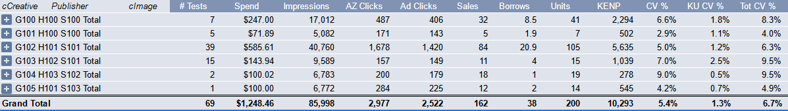
DATA: WHICH ADS Converted Best?
G103 H102 S101 and G104 H103 S102 converted at 9.5%
However, G102 H101 S101’s conversion might have been impacted by being used to test a bunch of audiences that might not have converted well

Slide 11
DATA: WHICH ADS Converted Best?
G104 H103 S102 converted 9.5% v. G102 H101 S101 @ 5.4% to the same aggregate audience of 3%+ CTR targets

Slide 12


DATA: WHICH ADS Converted Best?
G104 H103 S102
9.5% conversion
G102 H101 S101
5.4% conversion

Slide 13
BUT CONVERSION IS ONLY PART OF THE STORY
TRAFFIC
CONVERSION
DECREASE CPC + INCREASE CONVERSION TO DECREASE COST PER SALE (CPS)

Slide 14
Metrics
Cost per sale: spend / sales
Cost per unit: spend / (sales + borrows)
Base revenue per click: (sales revenue from advertised book + KENP revenue from advertised book) / clicks
Revenue per click: ((revenue per sale * sales) + (revenue per borrow * borrows)) / clicks
  Revenue per sale is often called “sellthrough value” and revenue per borrow is often called “readthrough value”
These give you common points of comparison

Slide 15
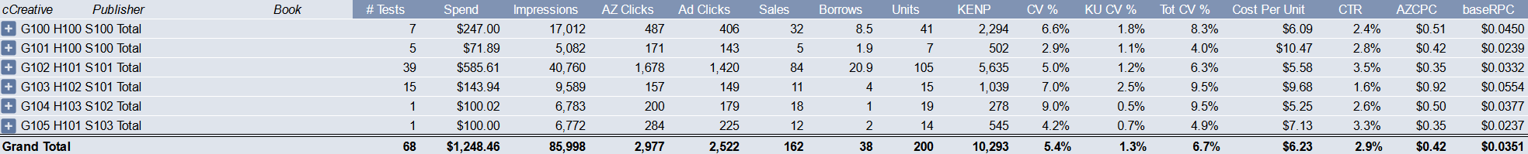
But Conversion is Only Part of the STory

Slide 16
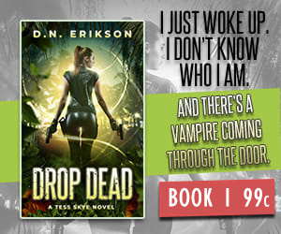
But Conversion is Only Part of the Story…Which ad performed Best?
G104 H103 S102
2.6% CTR
$0.50 CPC
9.5% conversion
$5.25 cost per unit
G102 H101 S101
3.5% CTR
$0.35 CPC
6.3% conversion
$5.58 cost per unit
G103 H102 S101
1.6% CTR
$0.92 CPC
9.5% conversion
$9.68 cost per unit

Slide 17
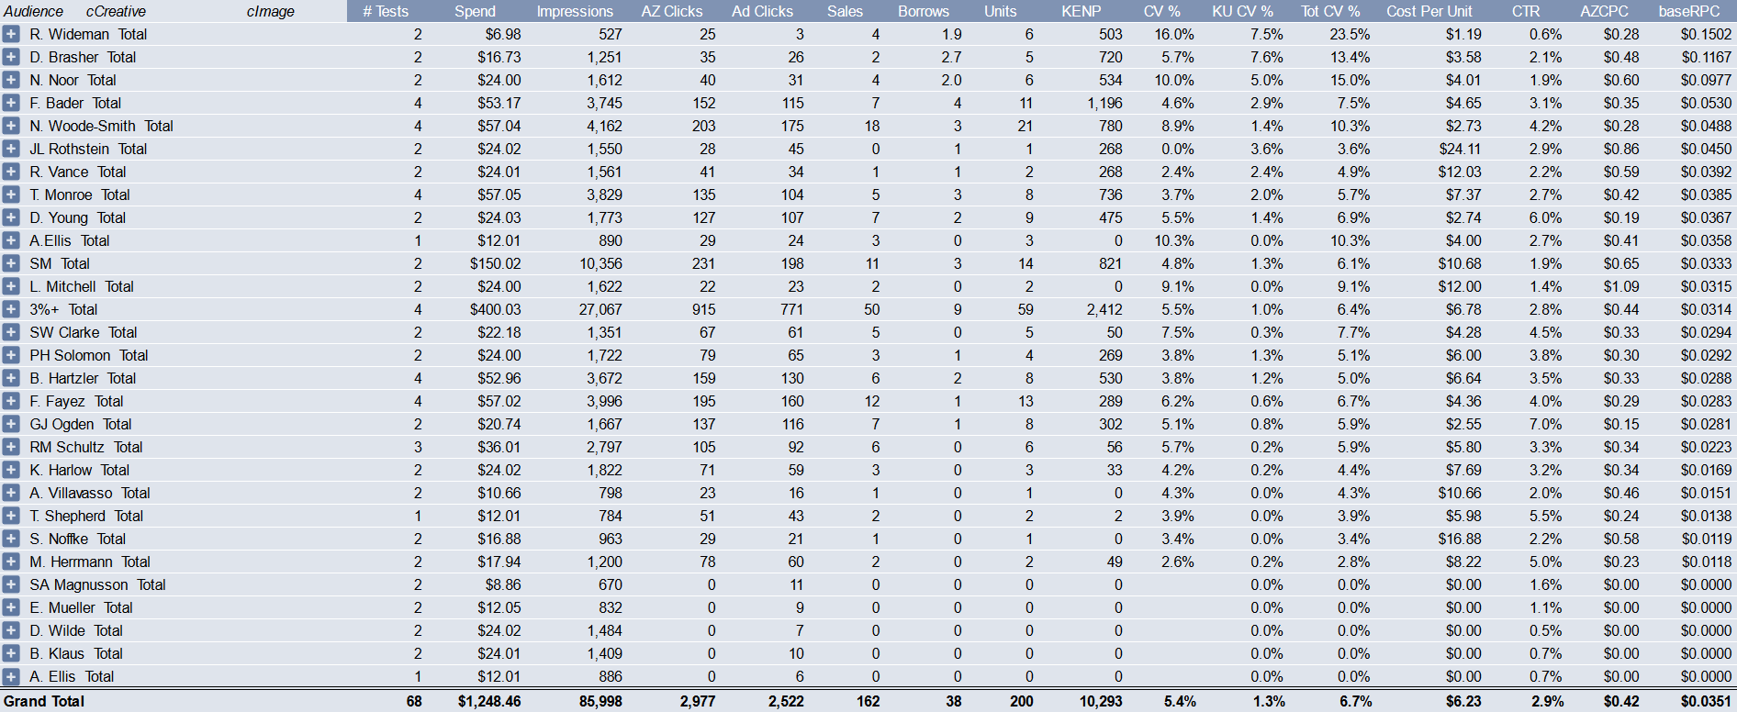
What AUDIENCES Performed Best?

Slide 18
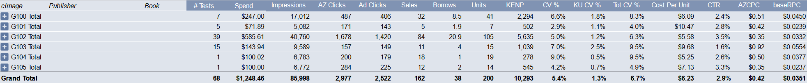
What Creative Elements Performed Best?

Slide 19
BUT EVEN THAT’S ONLY HALF THE STORY
Pricing
First Chapter
Series Length
Backlist in same genre / sub-genre
Sellthrough
  Cliffhangers
  Open Loops
  Spinoffs
  Concept
  Craft
  Cover (series branding)
  Back Matter CTAs
  Back Matter Excerpt
Newsletter subscribers
Branding (increases overall catalog value + intellectual property value)
Ads (FB / BB / AMZ etc.)
  Creative (copy / image / headline)
  Audience Targeting
  Platform Features
Ads
  FB / BB / AMZ ad congruence + creative quality
  Audience Targeting
  Platform Features
TRAFFIC
CONVERSION
PROFITABILITY
DECREASE CPC + INCREASE CONVERSION TO DECREASE COST PER SALE (CPS)
INCREASE REVENUE PER SALE and REVENUE PER BORROW

Slide 20
What WAS MOST PROFITABLE?
For the most complete picture, we need to factor in readthrough and sellthrough to the rest of the series with revenue per click.
Revenue per sale = $5
Revenue per borrow = $4
Profit per click = revenue per click – cost per click
  G100 H100 S100: ($5 * 32 sales) + ($4 * 8.5 borrows) / 487 clicks = $0.40 RPC
  $0.40 RPC - $0.51 CPC = -$0.11 profit per click

Slide 21
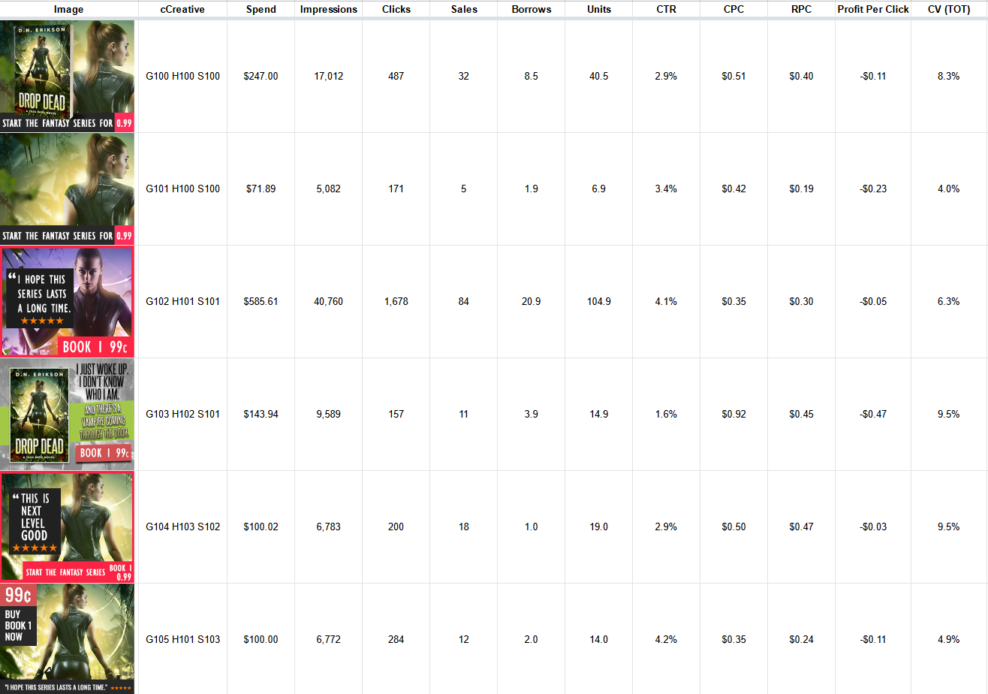
The Full sTory…Which ad Was Most Profitable?

Slide 22
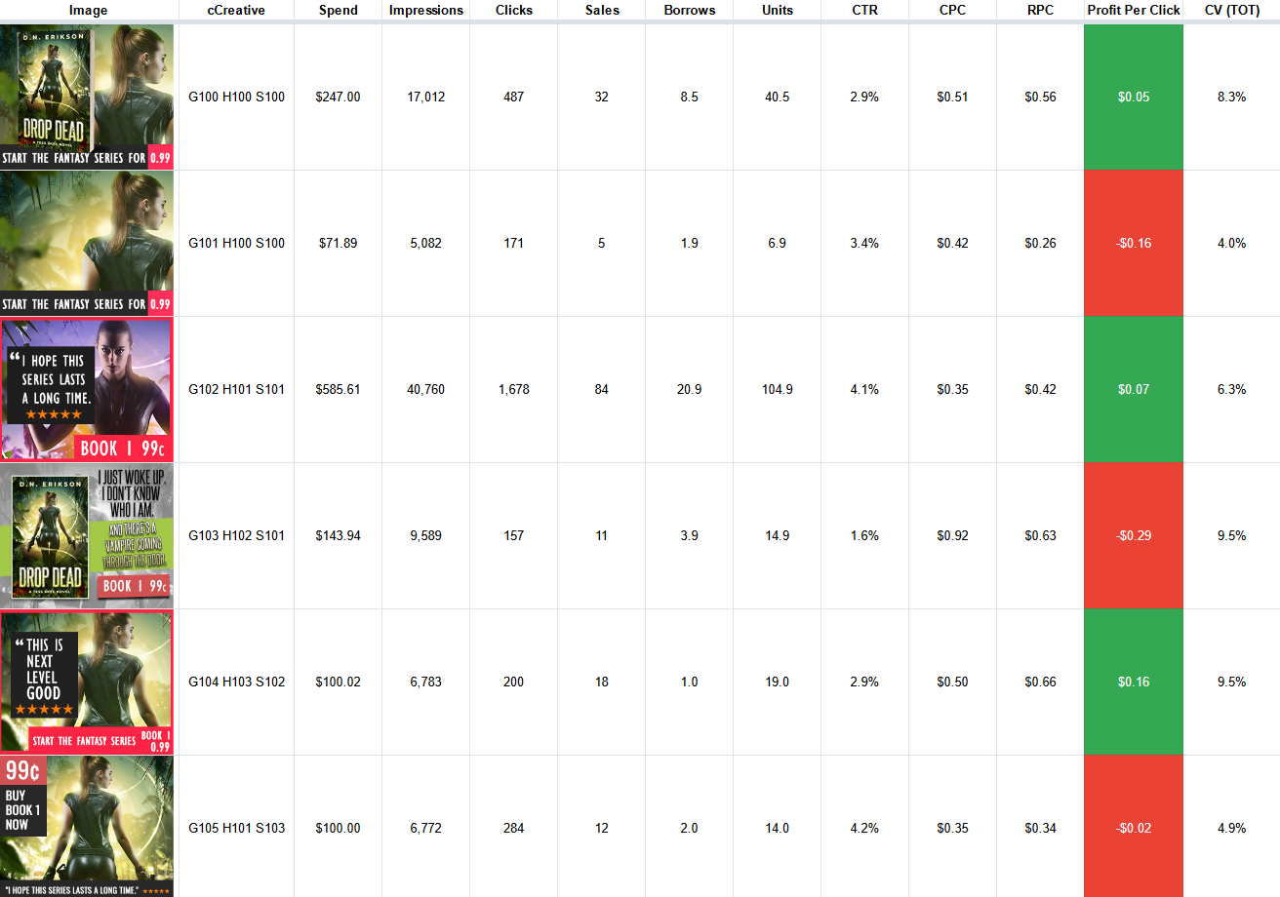
IF I WRITE 3 MORE BOOKS…Which ad WOULD BE Most Profitable?
Revenue per sale (sellthrough)
  $5 → $7
Revenue per borrow (readthrough)
  $4 → $5.50

Slide 23
DATA
Most powerful over time
This a single week’s worth of data
Imagine the insights over a year…two years…ten years.
More testing = more patterns and more winners
This is why Amazon, Facebook etc. are such massive companies: because of these insights.
This becomes a massive asset
  Re-use best images / copy / headlines
  Spot patterns so improve creative skills
  Improve covers because know what images are more likely to convert
  Improve blurbs by incorporating pieces of copy / headlines into them
  Better understand your audience by knowing who your target reader is

Slide 24
END

