Slide 1

AI AUTHOR MARKETING ACCELERATOR
HOW TO ACCELERATE YOUR MARKETING WITH THE 4X AI WORKFLOW

Slide 2
OVERVIEW
HYPE / HOW USEFUL IS AI, REALLY?
USE CASES
RECOMMENDED TOOLS
WORKFLOW with EXERCISES / RESOURCES: download Google Sheet at nicholaserik.com/4x-ai-exercises

Slide 3
Exercises
nicholaserik.com/4x-ai-exercises
Claude: claude.ai (free, $20 option gives more messages and can read longer documents, no additional features)
ChatGPT: chat.openai.com (free, $20 Plus option gives access to GPT-4 which is strongly recommended)

Slide 4
1: HYPE

Slide 5
HYPE
Is the hype real or is this just a bubble?
In other words, is AI worth spending time to learn about?

Slide 6
BCG Study
Boston Consulting Group (BCG) ran a study using 758 consultants.
  12.2% increase in tasks completed
  25.1% faster completion
  40% higher quality
    Biggest boost for bottom half of consultants: +43% (+17% for top half)
    Source: “Centaurs and Cyborgs on the Jagged Frontier” by Ethan Mollick, “Navigating the Jagged Technological Frontier: Field Experimental Evidence of the Effects of AI on Knowledge Worker Productivity and Quality”

Slide 7
Speed Test: ChatgPt v. Me
15 minutes, writing taglines
  Manually: 16 taglines
  ChatGPT (using GPT-4): 144 taglines (140 taglines from ChatGPT, 4 hand-written)
15 minutes, writing ad copy
  Manually: 14 pieces of copy
  ChatGPT (using GPT-4): 110 pieces of copy

Slide 8
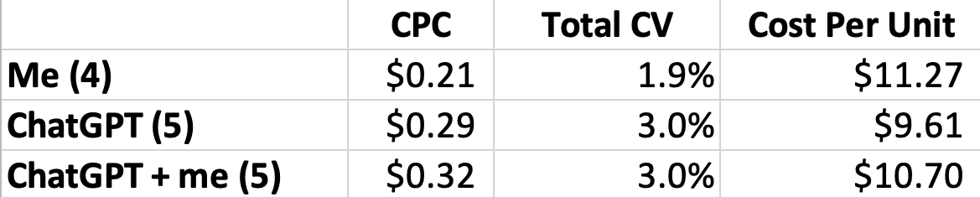
Performance: ChatGPT v. Me
Tested for same book at same time, using same settings / audience / images etc.
3 Book Box Set: wrote a blurb 26% conversion during pre-order tests at 99p (ChatGPT + me)

Slide 9
2: BeNEFITS

Slide 10
Benefits
Time
Volume (can test more options)
Different ideas (things you missed / hadn’t thought of)
Energy (even if time is the same, significantly less cognitive effort to curate or refine AI’s output than create it from scratch)
Quality (when working with the AI, not outsourcing all thought to it)

Slide 11
3: USE CASES

Slide 12
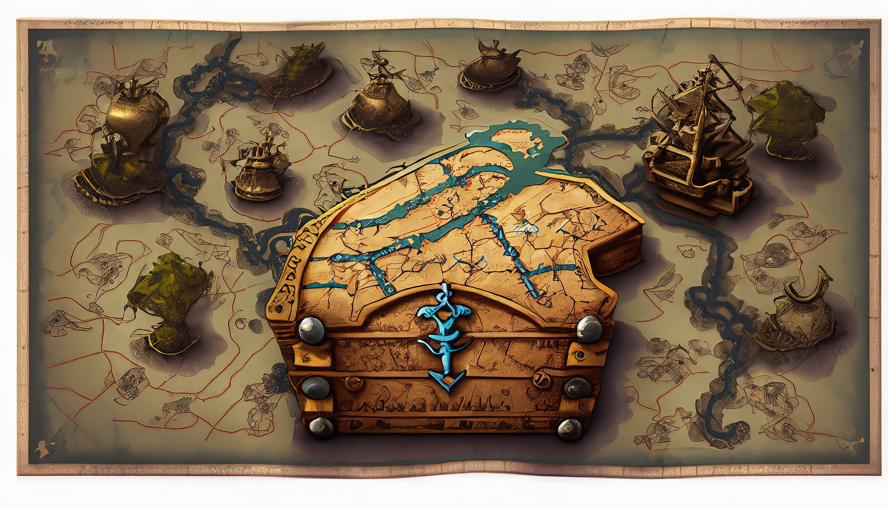
CHOOSE YOUR OWN AI ADVENTURE
AI is a powerful tool, but it’s not a magic bullet
Takes time / effort to experiment
A tool’s utility and positive / negative impact is on how people choose to use it
Adobe Firefly v1: treasure map with a bunch of paths each ending in a treasure chest

Slide 13
Use Cases
Blurbs
Taglines / headlines
Ad copy
Social media posts / content
Email subject lines
Market research
Idea generation machine: can come up with different ways to pitch the book that you will never otherwise think of or would take impractically long to execute (scenes, characters, plot points, language, different styles etc.)
Also a great tool for writing novels

Slide 14
Tools
Images: Adobe Firefly (trained on Adobe Stock library + public domain)
Writing: ChatGPT Plus / Claude
Fiction Writing: Sudowrite
Data Analysis: ChatGPT Plus (Advanced Data Analysis)
Automating Workflows: Zapier
More Customization: fine-tuning, training your own models
Most tools like Jasper etc. are using GPT-3 / GPT-4 or Claude’s API. They’re fine-tuned for a specific use case. They’re mostly interchangeable, don’t get bogged down finding the “perfect” one.
Read the Terms of Service
Check for commercial use, also what they’re using your data for

Slide 15
4x Workflow
Angles: lens that you view the book through; how you pitch the book to readers
  Billionaire Antagonist: Focus on Dom Rillo, the billionaire who has built an empire on the manipulation of supernatural powers and is threatening the town.
  Tess's Abilities as a Soulwalker: Focus on how Tess is a Soulwalker who can enter the bodies of the dead and access their memories.
  Amnesia: Focus on how Tess wakes up with no memory in a motel next to dead vampires.
Create Marketing Materials: blurbs, ad copy / social media posts / teasers
  Have to curate and revise. AI produces a lot of mediocre or weird output. Also sometimes likes very long sentences and to name every character / location.

Slide 16
Exercises
nicholaserik.com/4x-ai-exercises
Claude: claude.ai (free, $20 option gives more messages, no additional features)
ChatGPT: chat.openai.com (free, $20 Plus option gives access to GPT-4 which is strongly recommended)

Slide 17
EXERCISES

