Slide 1

THE Launch & PROMO Blueprint
THE $10k “OPTIMAL” LAUNCH CASE STUDY: SPELLS & CARAMELS (180d)

Slide 2
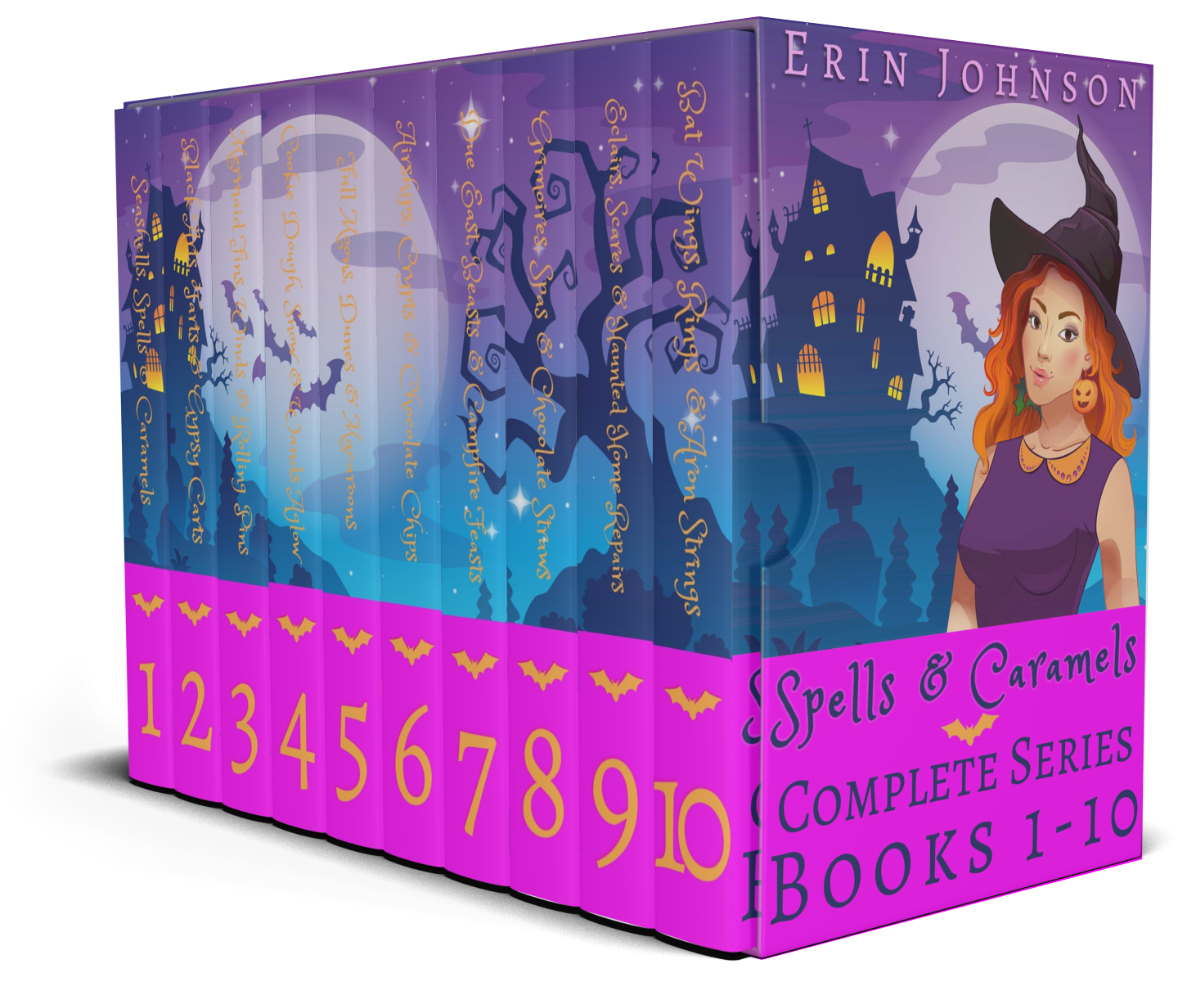
SPELLS & CARAMELS OVERVIEW
SERIES: Spells & Caramels
GENRE: Paranormal cozy
KENPC: 3,706 (only get paid up to 3,000)
Launched at 99c in April 2022, has stayed there since launch day

Slide 3
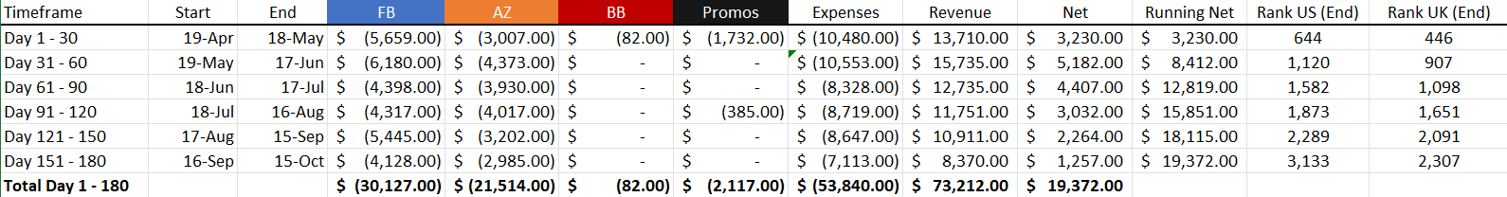
180 Day (6 Month) Numbers
Pre-order: tested 3 covers, 10 blurbs, tested FB / BB ads, started AZ ads
Day 1 – 30: initial launch; also released Magic Tea Room Book 5 on Day 15, KCD on MTR B1, B2, B3 on Day 21; cliff extender free run on SC1 Days 29 - 33
Day 31 – 60: backlist ads
Day 61 – 90: backlist ads
Day 91 – 120: repush - booked promo sites, increased ad spend
Day 121 – 150: backlist ads
Day 151 – 180: audio set released (~190 copies)

Slide 4
END

