Slide 1

LAUNCH CASE STUDY
THE $10k “OPTIMAL” LAUNCH CASE STUDY

Slide 2
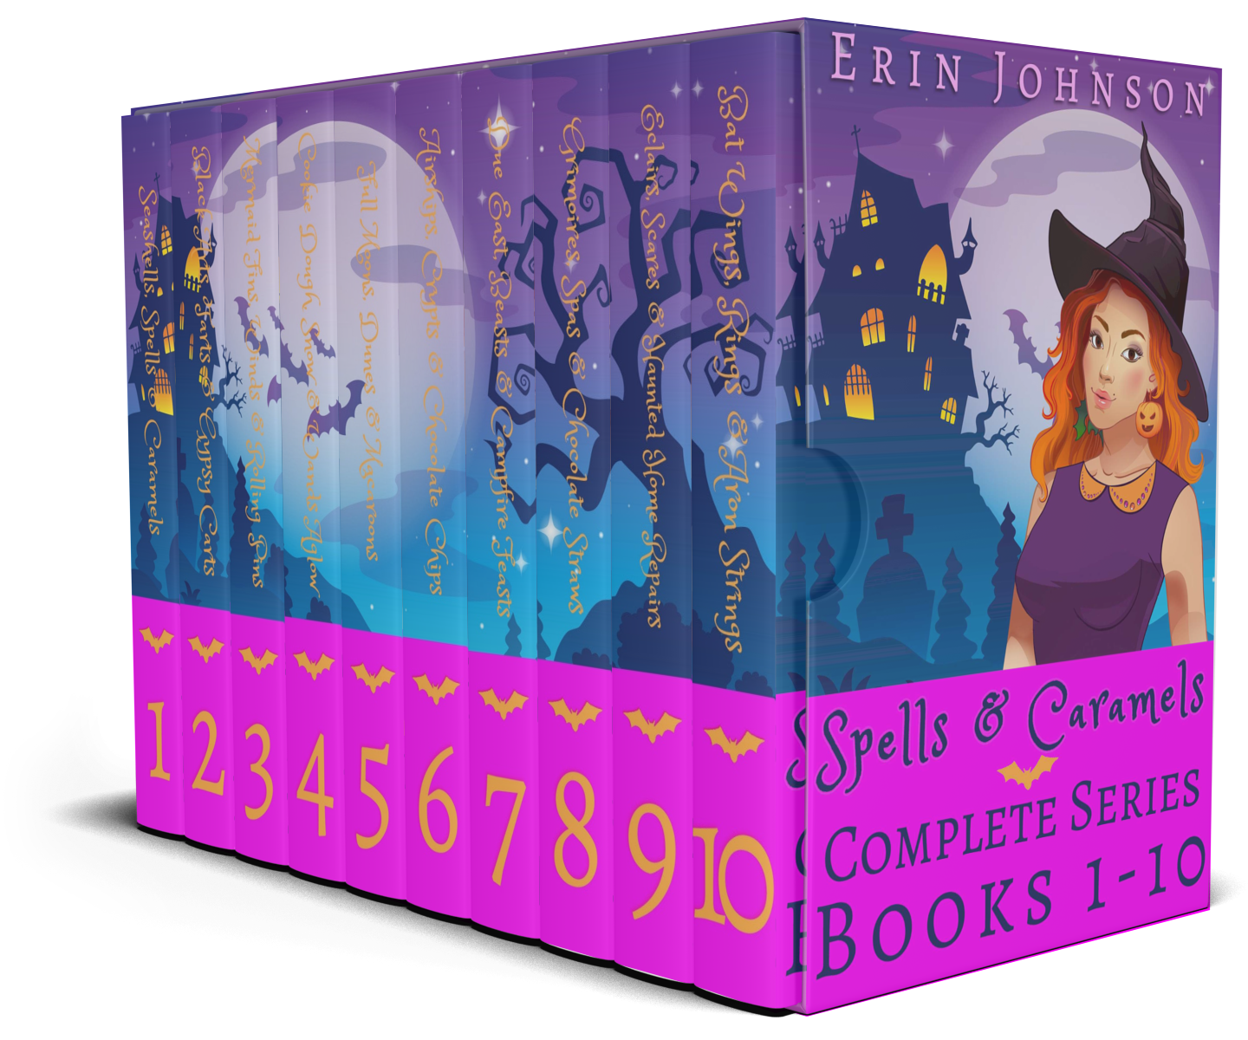
SPELLS & CARAMELS LAUNCH PLAN
SERIES: Spells & Caramels
GENRE: Paranormal cozy
KENPC: 3,706 (only get paid up to 3,000)

Slide 3
NOTES
Cozy mystery is very difficult to advertise in.
This is not just about KU / box sets.
Many principles / ad practices / strategies apply outside of Kindle Unlimited

Slide 4
LAUNCH BLUEPRINT
GOAL: profit
BUDGET: $10k+
EXCLUSIVITY: KU
PRICING: 99c
PREORDER: ~1 month (1670 pre-orders)
  Tested ads
  Tested covers / blurbs
LAUNCH DAY: April 19
LAUNCH WINDOW: 8 days
TRAFFIC: Facebook / Amazon / newsletter swaps / promo sites / BookBub Featured Deal
STRATEGY: 99c Kindle Unlimited box set launch

Slide 5
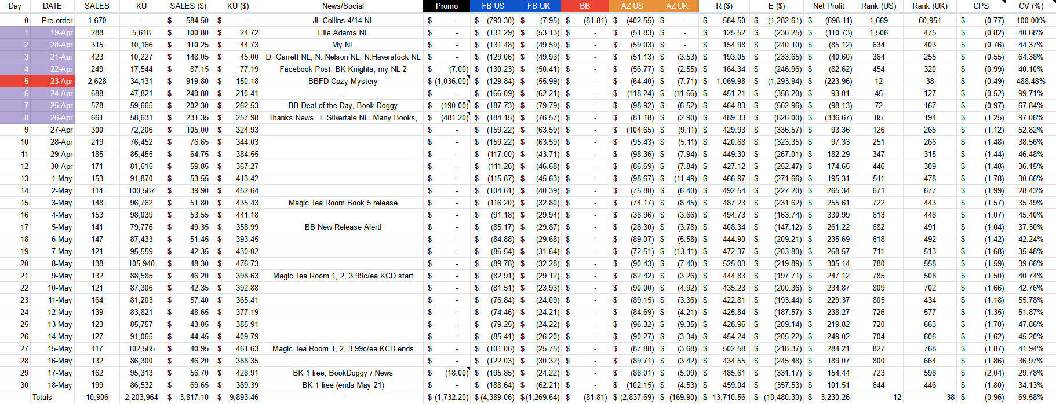
30d Numbers
PRE-ORDER (starting 1 month before)
Test AZ / FB / BB ads
Test covers / blurbs
Submit to BB
Schedule promo sites
DAYS 1 - 8
Main launch window / push
DAYS 9 – 30
Continue with AZ / FB ads
Day 15: new release in Magic Tea Room
Day 21: KCD on Magic Tea Room series
Days 29 – 33:
Free run on Book 1 to extend cliff

Slide 6
COMPLETE PLAN: WHAT MAKES THIS “OPTIMAL”
PRE-LAUNCH
  Submit: promo sites (if you have a free or 99c book / 99c box set)
  Submit: BookBub Featured Deal
  Organize: newsletter swaps
  Test: 3 covers
  Test: 10 blurbs
  Test: BookBub Ads / Facebook Ads
  Start: Amazon Ads (gain momentum)
LAUNCH
  Everything pre-scheduled / tested, so launch was easy + smooth.
  BookBub is a great piece to build around (can be something else with a lot of firepower—your newsletter / fanbase, for example, once those get to a certain point)
POST LAUNCH
  Book launch in another series Day 15 to ride + extend momentum
  Extending momentum with ads instead of letting things fade
    Amazon Ads
    Facebook Ads
    Book 1 free run cliff extender (algorithms / visibility)

Slide 7
99c Kindle Unlimited BOX SET
STRATEGY: release a box set of 1000+ KENP (more the better) containing at least Books 1, 2 & 3 (again, more books, generally the better)
  PRICE: Launch at 99¢ in KU
  KU/WIDE: Only works with a new set in Kindle Unlimited
TRAFFIC SOURCES: Facebook Ads / BookBub Ads / Amazon Ads / promo sites / newsletter / newsletter swaps (X-factor) / social media
UPSIDE
  Low to mid 5-figure upside
  Should at least break even in most instances due to reads
  Can pair with a corresponding audio set for even greater upside / start establishing audio fanbase
DOWNSIDE
  Potentially devaluing brand
  Requires big upfront ad spend (cash flow)
  If series was unsuccessful as individual novels, much riskier
  Can lose money if page reads don’t come in or PPC ads are performing poorly
  Tends to produce very few subs (note: here, Erin has a cookbook magnet at the end of Book 1 to produce more subs, as opposed to something only at the end of the 10th book)

Slide 8
PRE-LAUNCH

Slide 9
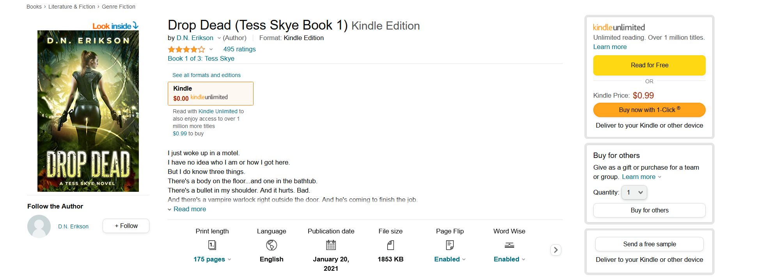
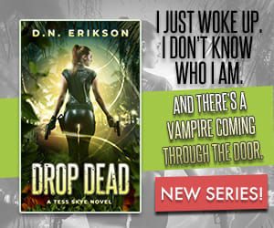
THE INTERNET MARKETING FORMULA
TRAFFIC
CONVERSION
PROFIT?

Slide 10
LEVERS IN THIS LAUNCH
TRAFFIC
CONVERSION
PROFITABILITY (RPS & RPB)
Test ads
Test covers
Test blurbs
Box set KENPC length
DECREASE CPC + INCREASE CONVERSION TO DECREASE COST PER SALE (CPS)
INCREASE REVENUE PER SALE (RPS)
/ DECREASE COST PER BORROW (CPB)
INCREASE REVENUE PER BORROW (RPB)

Slide 11
WHY THIS MATTERS
A better blurb / cover will not just convert better with the ads (thus getting you more sales / reads for the same amount of ad spend) but also convert better in non-ad scenarios:
  Swaps will produce more sales
  Your newsletter / social media will produce more sales
  Etc.
More profitability = more headroom to scale with the ads and making more money

Slide 12
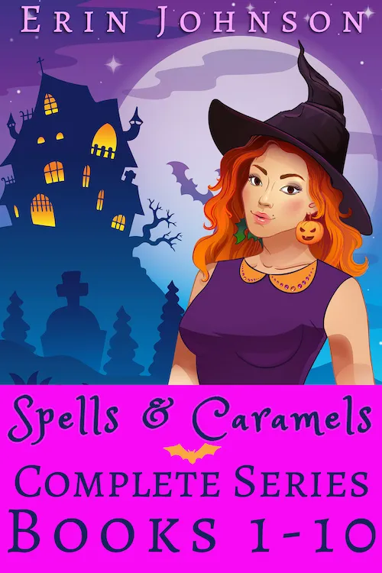
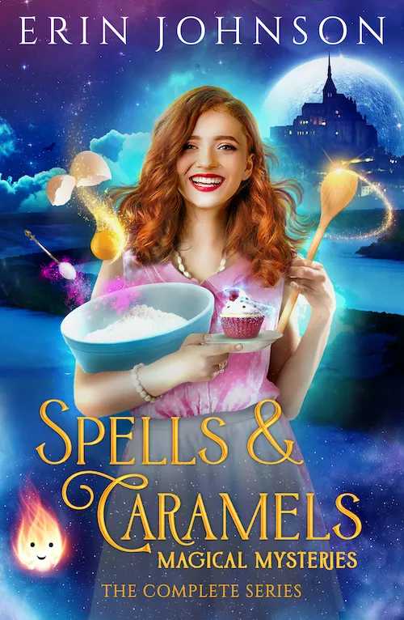
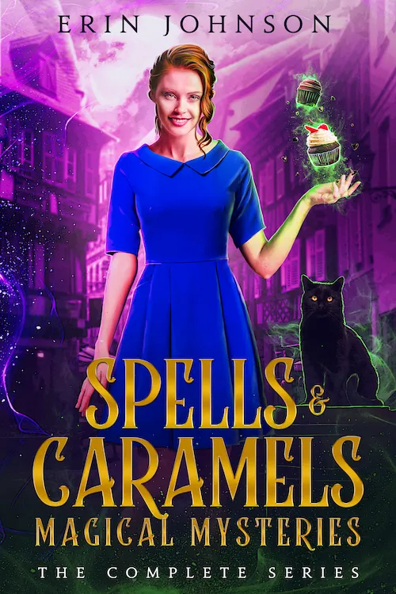
PRE-Launch: COVER TESTING
1
2
3

Slide 13
COVER TESTING GUIDELINES
REALISTIC MAX TEST VOLUME: 2 – 5 covers (3 covers here)
COST: $50 - $100 total per cover
  $320 design cost for two additional covers (already had vector cover)
  $167 on Facebook
  $487 total cost
IMPACT: 10/10
OBJECTIVE: Sales (Conversion)
DATA: need 50 – 200+ view contents per cover
WINNER: lowest view content cost
SETUP
  1 campaign
  1 ad set
    BIDDING: Campaign Budget Optimization
    REGION: US
    TARGETING: Proven audience (urban fantasy authors)
    PLACEMENT: News Feed Only

Slide 14
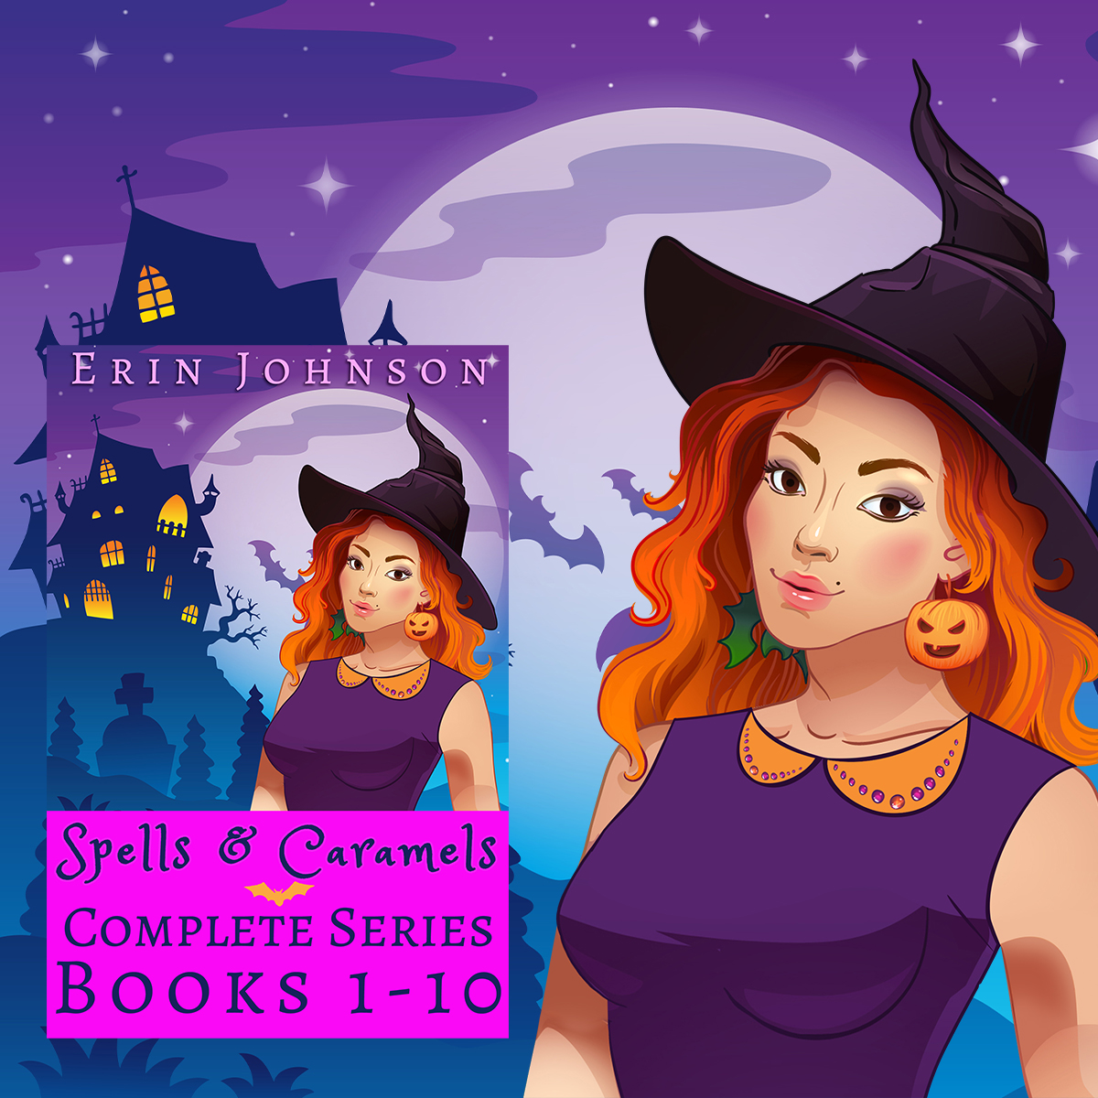
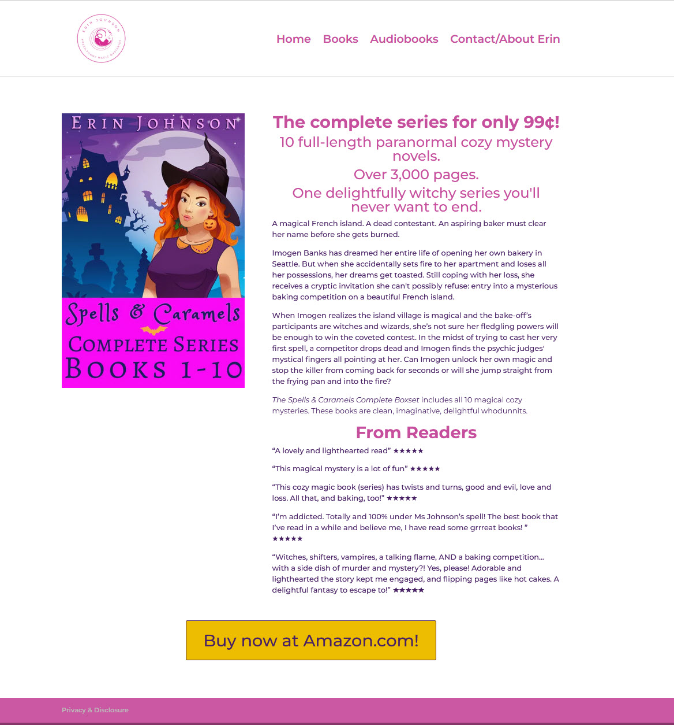
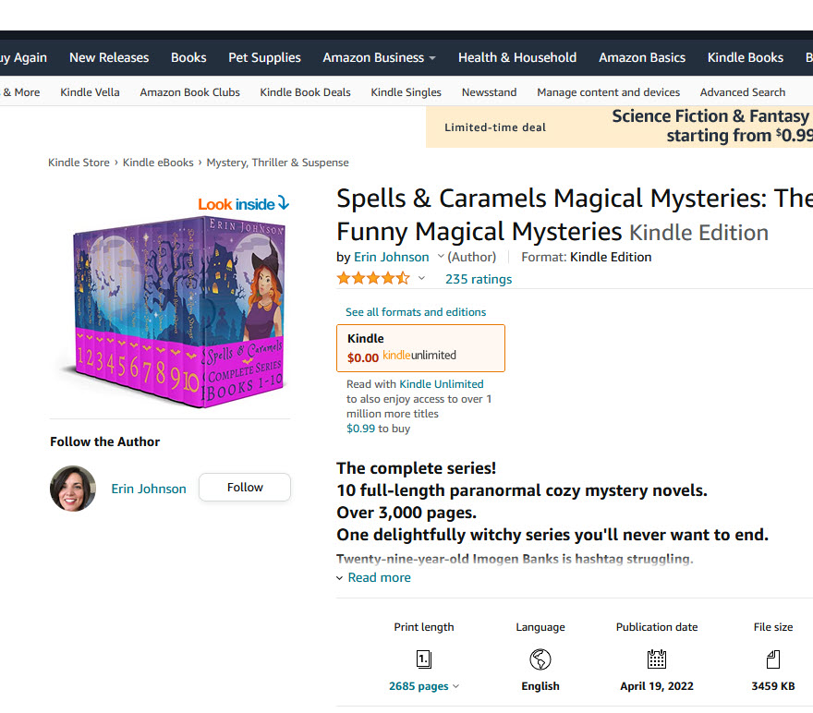
COVER TESTING GUIDELINES
Facebook Ad
IMAGE: Cover on book cover background
TEXT: blurb
HEADLINE: new [genre] book or new [genre] book Free in Kindle Unlimited
Amazon book page
Landing page on website
(clickthrough page)
Sales objective tracks clicks on button (view content)

Slide 15
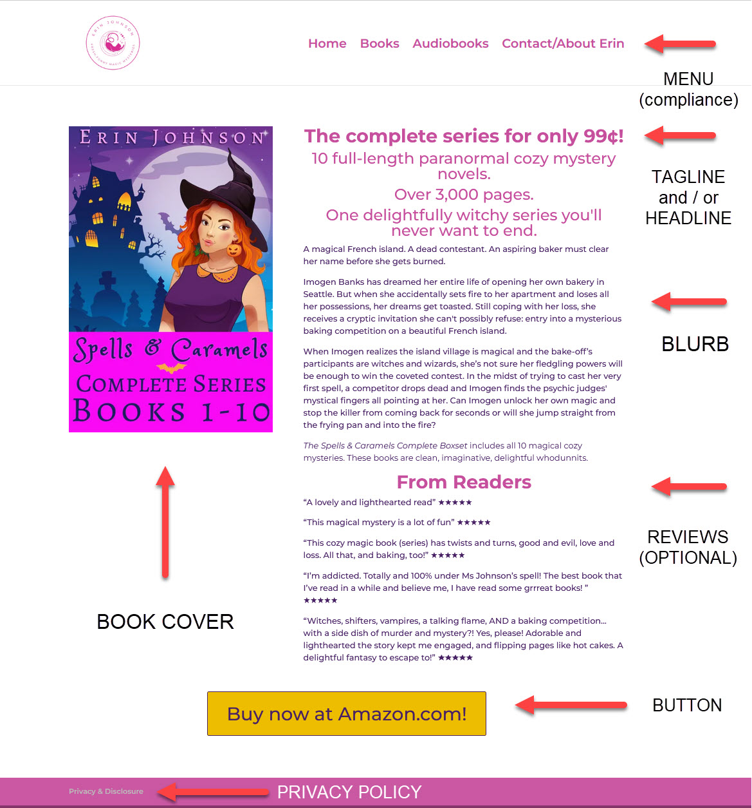

Slide 16
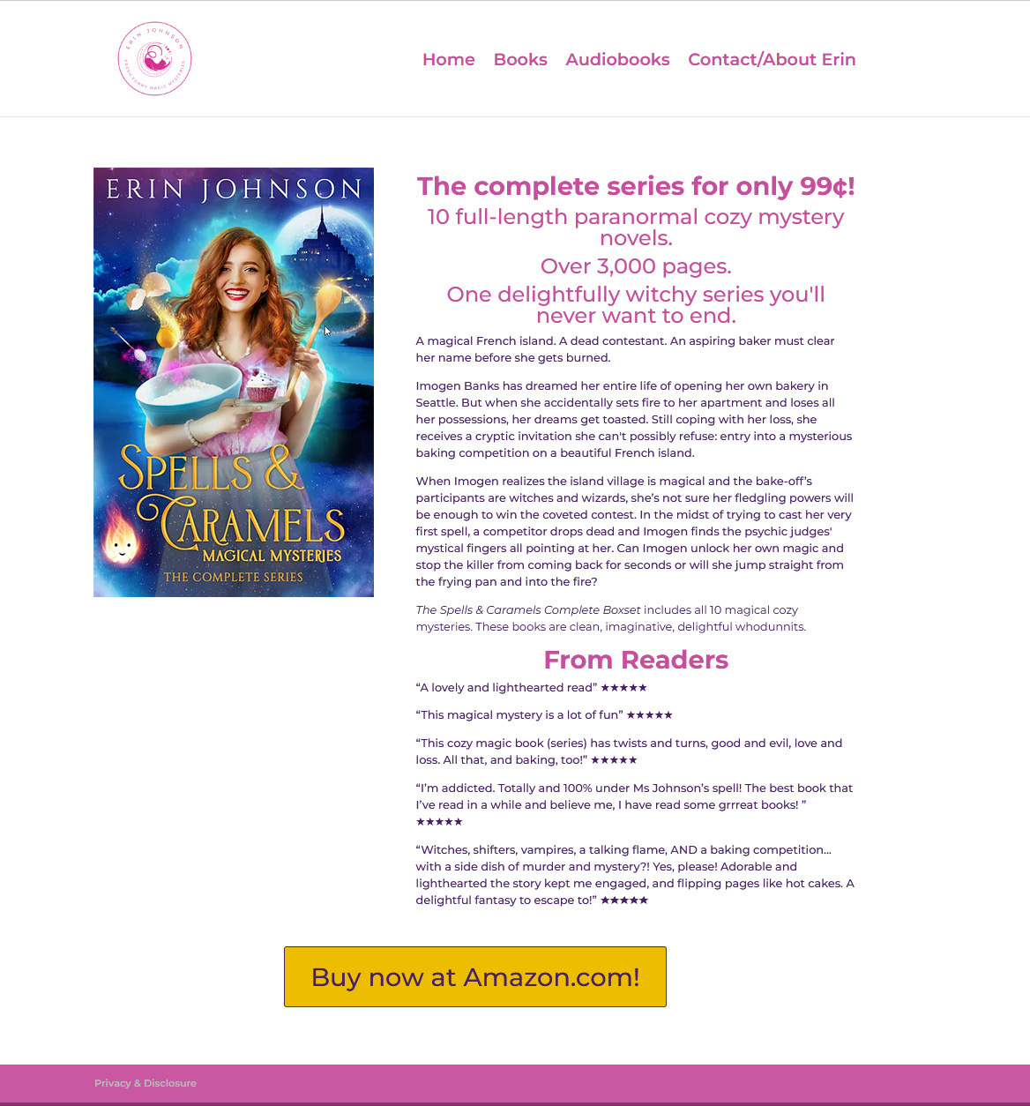
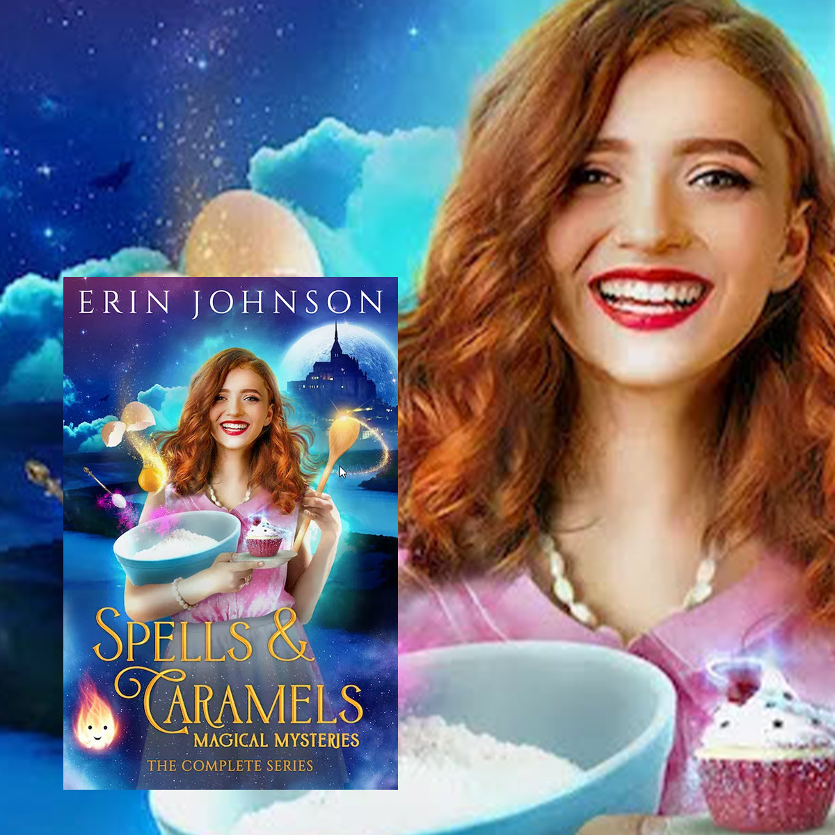
COVER TESTING GUIDELINES
Amazon book page
Facebook Ad 2
Everything identical except image
Landing page 2 on website
(clickthrough page)
Everything identical except image

Slide 17
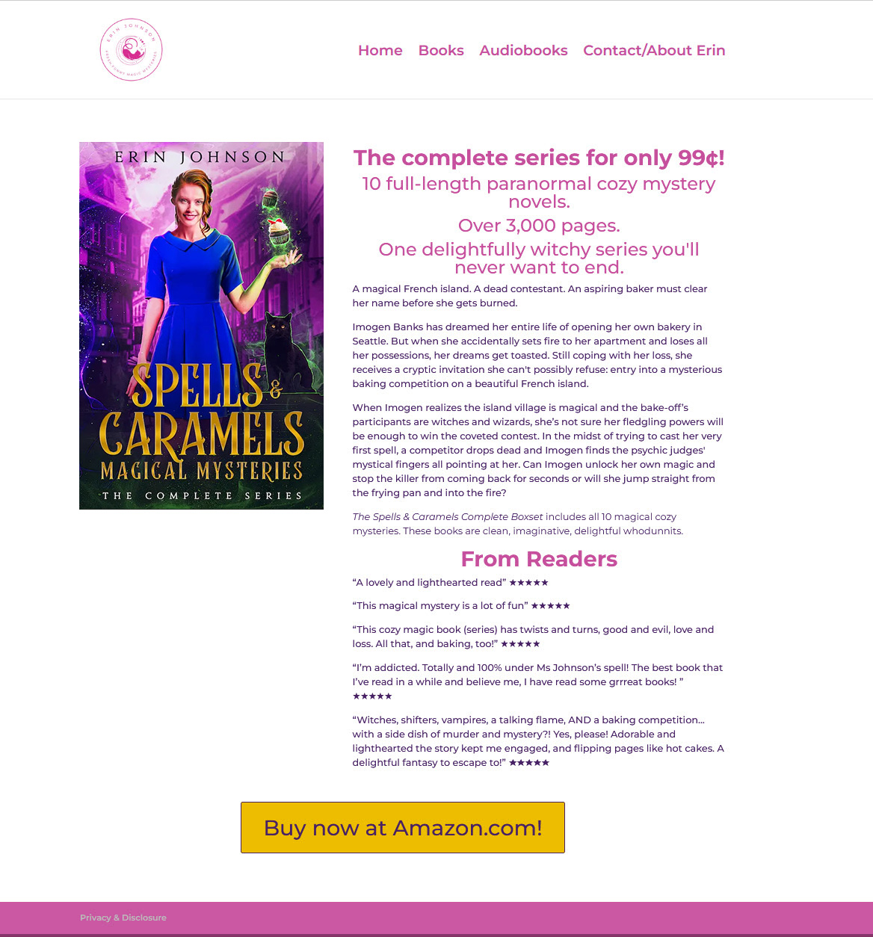
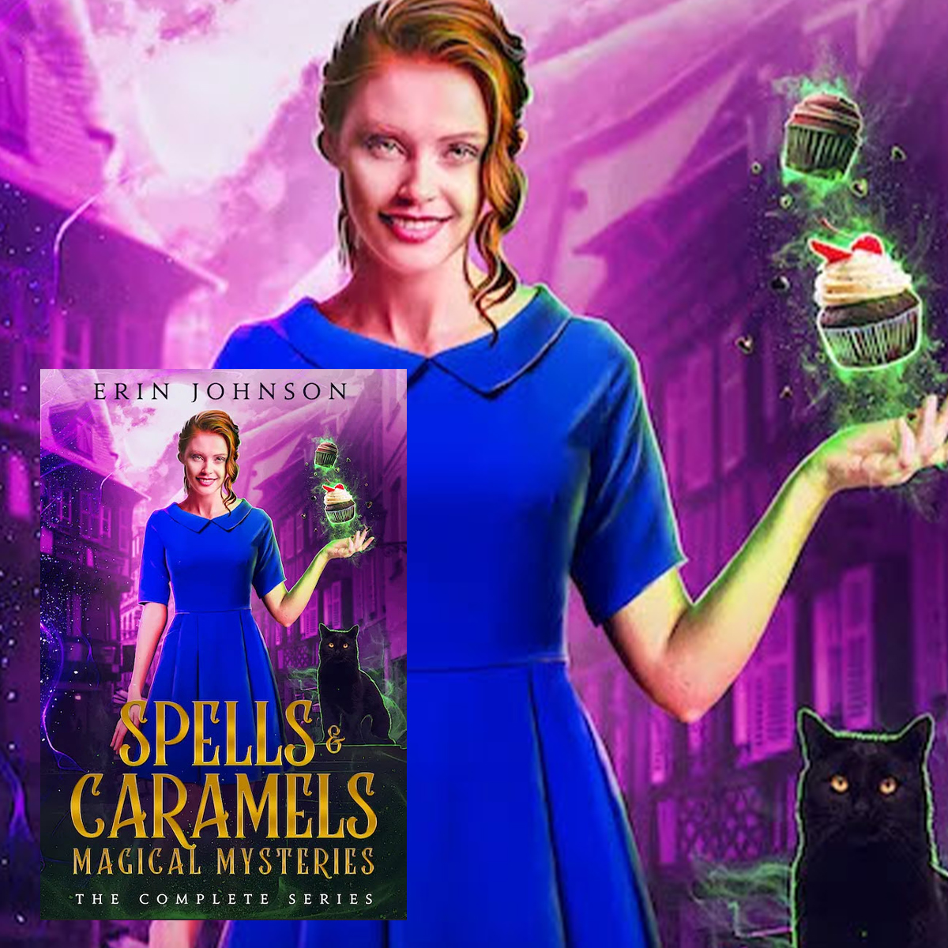
COVER TESTING GUIDELINES
Amazon book page
Facebook Ad 3
Everything identical except image
Landing page 3 on website
(clickthrough page)
Everything identical except image

Slide 18
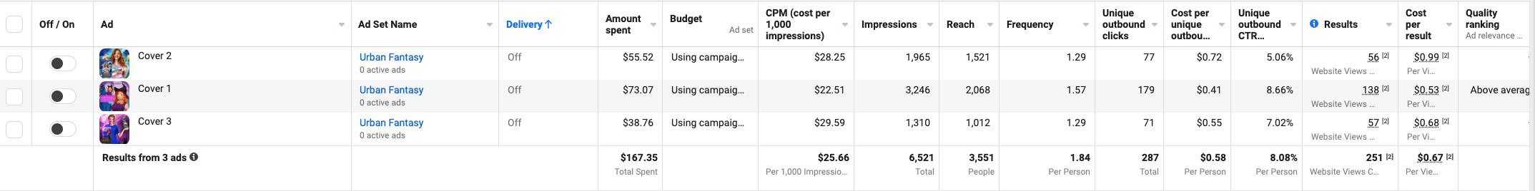
COVER TESTING GUIDELINES
Lowest view content cost

Slide 19
BLURB TESTING
REALISTIC MAX TEST VOLUME: 5 – 25 blurbs (10 blurbs here)
COST: $20 - $50 total per blurb
IMPACT: 9/10
OBJECTIVE: Traffic (can use the same process as outlined for cover testing, this is just an alternative that’s a bit easier)
DATA: need 30 – 100+ clicks per blurb
WINNER: lowest unique outbound CPC
SETUP
  1 campaign
  1 ad set
    BUDGETING: Campaign Budget Optimization
    REGION: US
    TARGETING: Proven audience (urban fantasy authors)
    PLACEMENT: News Feed Only

Slide 20
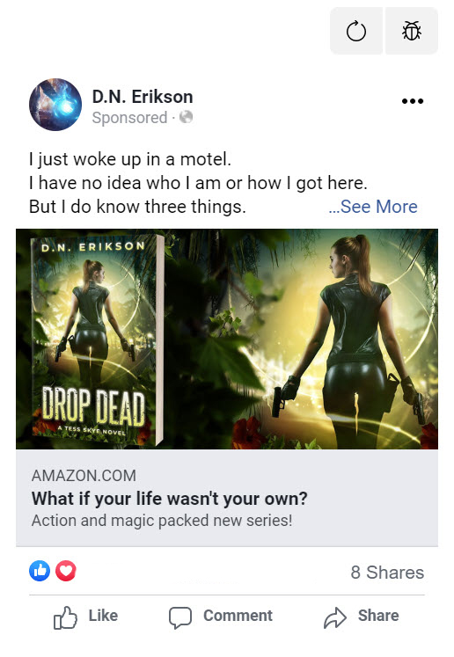
BLURB TESTING: Creative
TEXT
Blurb
This is the only thing that changes between the creatives. Everything else remains the same.
IMAGE
Book cover on book cover background
LINK
To Amazon
or Goodreads / website (if book isn’t live yet)
HEADLINE
New [Genre] Book
New [Genre] Free in Kindle Unlimited
Tagline (not recommended)

Slide 21
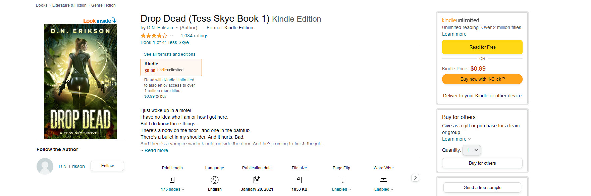
BLURB TESTING: Creative

Slide 22
15m BLURB EXERCISE
Set a timer for 7.5 minutes
  Hand copy (with a pen and paper) a blurb from the Top 100 of your sub-genre.
  Underline tropes and key structural elements to break it down.
Set a timer for 7.5 minutes
  Write your own blurb

Slide 23
COUPLE MORE TESTING NOTES
Whether using Sales or Traffic, run tests for 2 – 4 days. A single day’s worth of data can have a lot of variance / noise.
Try to aim for an audience size that’s 500k – 5m+ in size; if the audience is too small, then you can overoptimize the cover / blurb for a very specific audience

Slide 24
LAUnCH

Slide 25
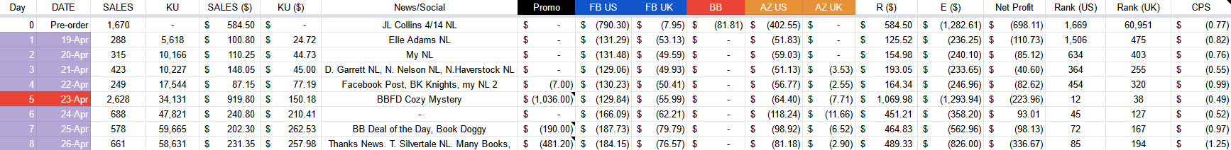
LAUNCH
Promo site stack
  Day 4: Bknights ($7)
  Day 5: BookBub Featured Deal in Cozy Mystery ($1036)
  Day 7: Bargain Booksy Deal of the Day / Book Doggy ($190)
  Day 8: Many Books, Book Adrenaline, Fussy Librarian, Robin Reads, Book Gorilla Starred, FKBT, eReaderIQ, BookRaid, BookCave ($481.20)
  Promo sites are going to be effective for free / 99c books / 99c box sets

Slide 26
BOOKBUB Ads
These are great for 99c box sets; also effective for 99c deals
Can work for permafree books to non-Amazon retailers, cost per click is usually prohibitive for free downloads to Amazon
Here, used as a supplement / safety net
  Facebook was working well
  Had the BookBub Featured Deal, so didn’t make sense to hammer the same audience at a much more expensive cost

Slide 27
BOOKBUB ADS
REGION / RETAILER: start with Amazon US only (unless wide, where you can test to everything BUT Amazon)
1 AUDIENCE: test one audience a time
BUDGET: $5, then bump up to $8 - $12, then to $15 - $20 (to confirm performance)
CPM: directly impacts CTR, so bid high (I usually do $20)
PACING: fulfill as quickly as possible
CTRs: 2%+ for a paid book is a promising audience; 4%+ for a free book
CREATIVE: more forgiving to test with a free, $0.99, or Kindle Unlimited book; generally easier to get clicks on a deal, even if your creative is mediocre
TARGETING
  TARGETS: 3k – 25k are best. Anything about 75k is not worth testing.
    Start with authors running BB ads (look at bottom of the BookBub email—authors running BB ads tend to be best targets)
    Can aggregate targets smaller than 3k together into a single audience to test them.

Slide 28
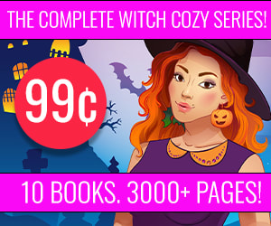
BOOKBUB CREATIVE
SPEND: $81
CLICKS: 116
CTR: 1.69% (best audience: 5.03%)
CPC: $0.71

Slide 29

FACEBOOK SALES ADS
Amazon book page
Facebook Ad
Landing page on website
(clickthrough page)
Sales objective tracks clicks on button (view content)

Slide 30
FACEBOOK: SALES ADS
This is what Facebook is built for
Pixel feeds data back on who is clicking on the button on the site
  This way, it can optimize and find more people like this (people who click on the ad AND the button are likely to be interested in reading the book). So this allows you to zero in on your target audience much better.
  It also gives you insight into what audiences / creatives are “converting” best, because of the tracking and this double-click process (someone has to click on not just the ad, but the button as well)

Slide 31
FACEBOOK: SALES ADS
Objective (Campaign): use Sales
Bidding (Campaign): use Campaign Budget Optimization (CBO). This is easier to manage, performs better, and is easily / quickly scalable.
Region (Ad Set): start with the US. If the ads are doing well and you want to try them in the UK, you can run your best winners there in a new campaign. Only do one region per campaign; this allows you to control the budgets to each region you want to run ads to.
Audience (Ad Set): start with your best performing audience (or your best aggregate audience), then add other audiences as you need to scale.
Placements (Ad Set): two options
  Remove Messenger and Audience Network, but leave everything else
  News Feed only
Event (Ad Set): make sure this is set to “view content” (or whatever you’re using as the conversion event)
Events Manager (Menu at Top Left): Make sure you set up the Event using the Events Manager to track whatever action on the landing page you want to treat as the conversion (usually clicks on a button).
Pixel Check: Confirm that the pixel is firing correctly on your website’s landing page with the Facebook Pixel Helper Chrome extension.
CAPI: installing the Conversion API (optional) improves the tracking.

Slide 32
FACEBOOK: SIMPLE ALTERNATIVE
One campaign.
Objective (Campaign): Traffic
Bidding (Campaign): use Campaign Budget Optimization (CBO)
Region (Ad Set): start with the US. If the ads are doing well and you want to try them in the UK, you can run your best ads there in a new campaign. Always do only one region per campaign; this allows you to control the budgets to each region you want to run ads to.
Audience (Ad Set):
  Ad Set 1: best performing aggregate audience of authors + genre.
  Ad Set 2: page engagement audience for last 365 days, website audience for last 180 days, and newsletter audience (all aggregated together; optional)
Placements (Ad Set): select “manual” and then only the Facebook News Feed
Optimization (Ad Set): make sure “link clicks” is selected (this is at the very bottom)

Slide 33
FACEBOOK: SIMPLE ALTERNATIVE
Creative (Ad) (can run $3,000 – $5,000 using this before it burns out)
  Link: direct to Amazon book page
  Image: Book Cover on Book Background (square)
  Text: book blurb or part of book blurb
  Headline:
    New [genre] Free in Kindle Unlimited
    New [genre] novel
    Enthusiastic review quote that mentions the genre
    Tagline (riskier, not recommended)

Slide 34
FACEBOOK: Creatives
Creative
  Image
    Book cover on Book Background
    Book cover on stock photo
    Book cover backgrounds
    Stock photos composited together (“infinite creatives”)
    Stock photos
  Copy
    Blurb
    Teaser: 1 – 2 sentence teaser, review quote, call to action
    Excerpts
  Headline:
    New [genre] Free in Kindle Unlimited
    New [genre] novel
    Enthusiastic review quote that mentions the genre
    Taglines
    Look at the Facebook Ads Library—not just for your sub-genre, but for the bestselling authors in the entire store

Slide 35


FACEBOOK ADS: INFINITE CREATIVES
+
    Use remove background tool from Canva, BookBrush, or Remove BG
    on figure, then place on new background

Slide 36
FACEBOOK ADS: INFINITE CREATIVES

Slide 37
FACEBOOK ADS: AUDIENCES
  Author interests (contemporary): EL James / Sylvia Day / Nora Roberts / Danielle Steel / Diana Gabaldon / Contemporary Romance (genre)
  Author interests (paranormal): Nalini Singh / Patricia Briggs / Laurell K. Hamilton / Kim Harrison / Ilona Andrews / most of the other paranormal authors that come up in suggested besides Cassandra Clare / paranormal romance (genre)
  Author interests (urban fantasy / paranormal): Jim Butcher / Ilona Andrews / Patricia Briggs / Kim Harrison / Laurell K Hamilton / urban fantasy (genre)
  Author interests (mystery / crime / thriller): Lee Child / James Patterson

Slide 38
AMAZON ADS
“Secret” to using Amazon Ads for a launch: get them up 2 – 4 weeks before the launch day.
  This gives them time to start serving, building sales history, and also gives you data with which to refine them.
Started the first ad on March 17 (a month before launch on April 19)
Then gradually added more during pre-order period
Goal isn’t to sell a ton of books (this can happen with a 99c box set, though) or scale super high during pre-order.
Ads will convert worse / be less efficient during the pre-order. Also, people can’t “pre-borrow,” so any KU books won’t be generating reads.

Slide 39
AMAZON ADS
Keyword ads (35% total)
  Author keywords (e.g., “amanda lee”) (started by pulling best performers from Book 1’s ads) (20%)
  Genre keywords (e.g., paranormal cozy mystery) (10%)
  Generic keywords (e.g., kindle unlimited cozy mystery) (5%)
Auto ad (30%)
Kindle Category targeting all relevant categories (30%)
ASINs targeting box sets (unique to box sets) (5%)
UK: took best performing author / genre / generic keywords in US and rolled out to UK.

Slide 40
LAUNCH

Slide 41
POST-LAUNCH

Slide 42
APPROACH
Kept Facebook / Amazon Ads going
  Sales ads on Facebook can maintain efficiency and actually improve (due to more data) with age
  Amazon Ads can improve with time due to refinement
  Big mistake to cut all ad spend—this is common with launches and can pull the rug out on things. More profitable / prolongs tail if you keep ads going.
Launch stack
  Having two launches or a launch + large promo in same month can supercharge results, as they can build off one another’s momentum.
  Steeping Secrets (Magical Tea Room Book #5) came out May 3 (15 days into box set launch)
  KCD on Books 1, 2 and 3 at 99c / 99p each May 9 – May 15.
Cliff extender
  Day 29 – Day 33: free run on Book 1.
  A few promo sites + newsletter / social.
  Gives things a shot in the arm as visibility is dropping / going over the cliff. Signals to the algorithms that the book is still selling and worth recommending.

Slide 43
PRICING
Two options after initial launch window (usually 7 – 14 days; here it was 8 days)
Flip back to full price (usually $6.99 - $9.99) or a lower, still discounted price where you get 70% royalties (e.g. $2.99 - $4.99)
  Can continue advertising or cut; ads can still perform well at a discount of ~$2.99, conversion becomes more difficult as price rises.
  Can focus on Kindle Unlimited angle instead in ads to sustain momentum—this can still convert well even at higher prices.
Keep at 99c indefinitely (recommended / what we did here)
  This is the highest upside option that prolongs momentum, provided the initial launch of the set goes well and numbers look good.
  Can continue to produce page reads + sales for months, especially if you keep advertising.
  Much easier to sustain visibility + momentum at 99c because of massively increased sales volume v. higher price points; still ranked at 915 (US) and 574 (UK) on May 31 (almost 6 weeks after launch)
  Keep things at 99c until the sales / reads taper off dramatically (out of the top 10k of the store)
  Note that you can also repush as things start to taper off—three months, six months, book more promo sites, push with ads etc. to boost set again.

Slide 44
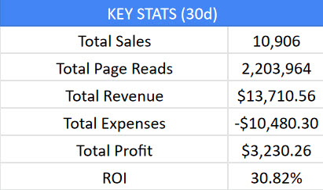
NUMBERS
May 2022 will hit around $24k - $25k total.
First time breaking $20k.
Around double previous top month.
Box set will make around $13k - $14k for May
Box set was still averaging around $500/day in total revenue as of May 28.

Slide 45
5 Takeaways
PRE-LAUNCH: testing ads during the pre-order, getting things scheduled makes the launch itself almost boring.
  This doesn’t mean you have to spend super aggressively; with the ad costs associated with the cover / blurb testing, this cost around $1,300.
TEST COVERS + BLURBS: increases conversion. Better cover + blurb improves your ad performance, whether that’s for a launch, promo, or backlist. It also impacts the organic / free side, so if you’re using swaps, social media, your newsletter etc. then you’ll get more sales.
TEST ADS: you usually have to test significantly more ads than you’re anticipating to get the performance / CPCs you’re looking for.
REPACKAGE: Book 1 came out in Oct 2017; Book 10 came out in April 2019. Three years old. Has generated ~$20k+ in revenue in ~6 weeks. Series has generated ~$14k total year to date.
  Think long-term: your books have a long life.
LEVEL UP: look for strategic opportunities to stack firepower together + chain different promos / launches together to create momentum and something that’s more than the sum of its parts.

Slide 46
END

